Slide 1

MIT-WPU Final Year (B.Tech) System Software and Compiler Design

Slide 2
Unit I
Introduction to System Software and Assembler Design
Need and Components of system software:
Assembler, Compiler, Interpreter,
Macro processor, Linker, Loader,
debugger, text editor,
Micro services and containers.
Assembler: Elements of Assembler language programming,
Machine dependent and machine independent assembler features,
Design of 2 pass Assembler.

Slide 3
Text Books & Reference Books
Text Books:
1.Dhamdhere D., "Systems Programming and Operating Systems", McGraw Hill, ISBN 0 -
07 -463579 – 4.
2. A V Aho, R Sethi, J D Ullman, \Compilers: Principles, Techniques, and Tools",
Pearson Edition, ISBN 81-7758-590-8.
3. John Donovan, “System Programming”, McGraw Hill, ISBN 978-0--07-460482-3.
Reference Books:
1. John. R. Levine, Tony Mason and Doug Brown, “Lex and Yacc”, O'Reilly, 1998, ISBN:
1- 56592-000-7.
2. Leland L. Beck, “System Software An Introduction to Systems Programming” 3rd
Edition, Person Education, ISBN 81-7808-036-2.
3. Adam Hoover, “System Programming with C and Unix”, Pearson,2010

Slide 4
Software
Introduction to System Software
Software is a set of computer programs which are designed
and developed to perform specific task desired by the user or
by the computer itself.
Software is a set of computer programs which are designed and developed to perform specific task desired by the user or by the computer itself.
Software
System Software
Application Software
System Control Programs
System Support Programs
System Development Programs
General Purpose
Special Purpose

Slide 5
System Software
Collection of programs
Designed to
Operate
Control
Extend the processing capabilities of the computer itself.
Prepared by computer manufacturers.
Perform functions
File editing,
Storage management,
Resource accounting,
I/O management, etc.
Notes:
The system software is collection of programs designed to operate, control and extend the processing capabilities of the computer itself.
These are generally prepared by computer manufacturers.
These software perform a variety of functions like file editing, storage management, resource accounting, I/O management, etc.

Slide 6
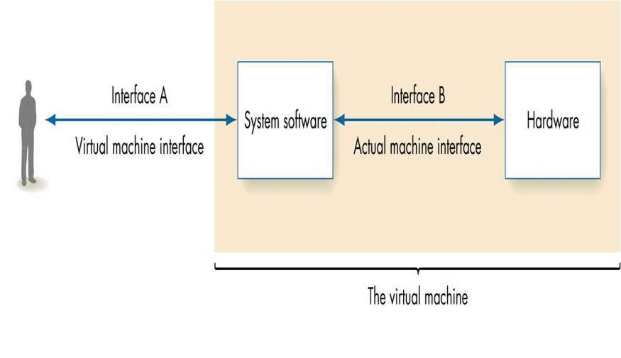
Role of System Software

Slide 7
Types of System Software
System Control Programs :
They control the execution of programs
Manage the storage and processing resources of the computer
Perform other management and monitoring functions.
e.g., OS
System Support Programs :
Provide routine service functions to other computer Programs and computer users.
e.g.Utility Programs
System Development Programs :
Assist in the creation of publication programs.
e.g., Language translators like interpreters,

Slide 8
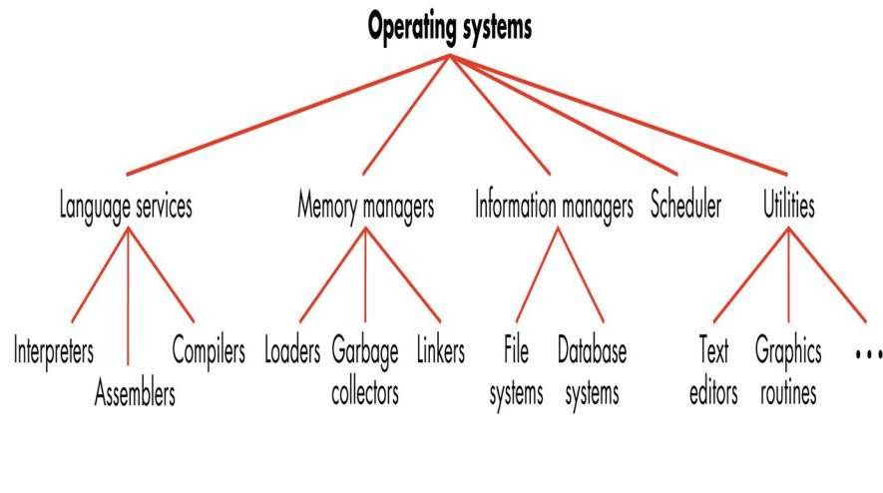
System Control Programs-OS
An OS is an integrated set of specialized programs that are used to manage overall resources of and operations of the computer.

Slide 9
System Development Programs-Language Translators
Language translators are also called language processors.
Main functions are :
Translate high level language to low level language.
Check for and identity syntax errors
There are 3 types of translator programs-
Assembler
Interpreter
Compiler

Slide 10
Assemblers
Assembly Language Program ---------------
Machine Language Program -------------------
Programs known as assembler is used to translate assembly language into machine language.
The input to an assembler is called the source program and the output is a machine language translation(object program).
Assembler tasks:
Convert symbolic op codes to binary
Convert symbolic addresses to binary
Perform assembler services requested by the pseudo-ops
Put translated instructions into a file for future use

Slide 11
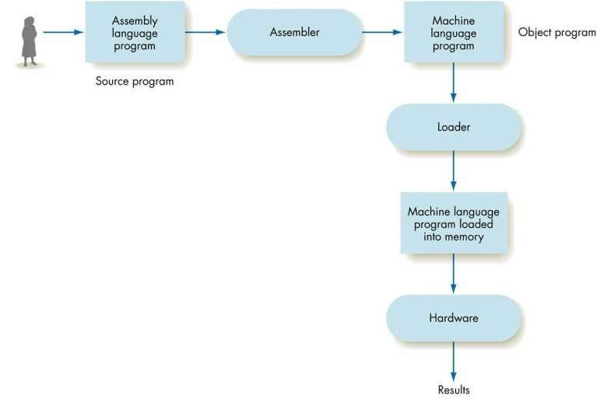
Assembler Task

Slide 12
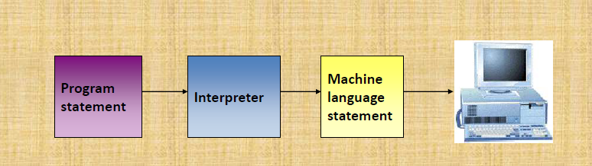
Interpreter
A language translator that translates one program statement at a time into machine code.

Slide 13
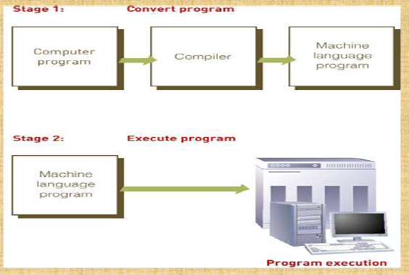
Compiler
A language translators that converts a complete
Program into machine language to produce a program that the computer can
Process.

Slide 14
Macro Processor
It permits the programmer to define an abbreviation for a part of his program and use the abbreviation in our program.
A macro represents a commonly used group of statements in the source programming language.
The macro processor replaces each macro instruction with the corresponding group of source language statements. This is called expanding the macros.
Eg: RDBUFF and WRBUFF

Slide 15
Linkers
Steps in program Execution
Translation
Linking
Relocation
Loading
Translated Address (Translated origin)
Linked Address (Linked origin)
Load Time Address (Load origin)
Translator
Linker
Loader
Source Program
Binary Program
Binary Programs
Object Modules

Slide 16
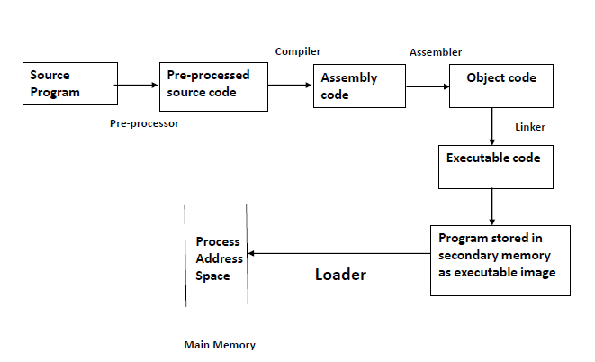
Loader

Slide 17
Loaders
Functions of loader:
Allocation
Loading
Relocation
Linking
e.g.
Bootstrap loader, IBM OS/360

Slide 18
Loader
Performs the loading function.
Process of placing the program into memory for execution
Responsible for initiating the execution of the process

Slide 19
Debugger
A debugger is a software program used to test and find bugs (errors) in other programs .
A debugger is also known as a debugging tool.
There are two types of debuggers :
CorDBG (command-line debugger) – in this , compilation of the original c# file using the debug switch is a must.
DbgCLR (graphic debugger) – used by Visual Studio .NET

Slide 20
List of Debuggers
Some widely used debuggers are:
Firefox JavaScript debugger
GDB - the GNU debugger
LLDB
Microsoft Visual Studio Debugger
Valgrind
WinDbg
Eclipse debugger API used in a range of IDEs : 1. Eclipse IDE (Java) 2. Nodeclipse (JavaScript)
WDW, the OpenWatcom debugger

Slide 21
Text Editor
Primary interface to the computer for all type of “knowledge workers”.
They compose, organize, study, and manipulate computer-based information.
A text editor allows you to edit a text file (create, modify etc…).
The common editing features are:
Moving the cursor,
Deleting
Replacing
Pasting
Searching
Searching and replacing,
Saving and loading, and,
Miscellaneous(e.g. quitting)

Slide 22
Examples
Windows OS - Notepad, WordPad, Microsoft Word, and text editors.
UNIX OS - vi, emacs, jed, pico.
Gui based editors
• Gedit gvim
Nedit
Tea
subtime

Slide 23
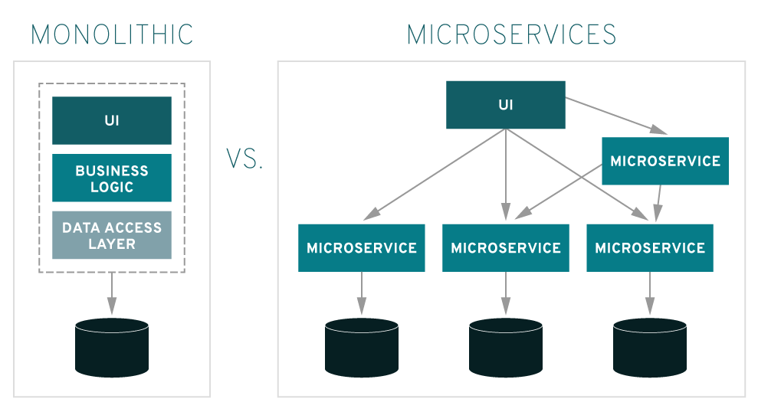
Microservices
Microservices are an architectural approach to building applications. As an architectural framework, microservices are distributed and loosely coupled, so one team’s changes won’t break the entire app.
The benefit to using microservices is that development teams are able to rapidly build new components of apps to meet changing business needs.

Slide 24
Microservices
Microservices are a software development technique
Microservices - also known as the micro service architecture
A variant of the service-oriented architecture (SOA) structural style that arranges an application as a collection of loosely coupled services.
In a microservices architecture, services are fine-grained and the protocols are lightweight.
It is an architectural style that structures an application as a collection of services that are:
Highly maintainable and testable
Loosely coupled
Independently deployable
Organized around business capabilities
Owned by a small team

Slide 25
Containers
A microservice is an application with a single function, such as routing network traffic, making an online payment or analyzing a medical result.
Containers are easily packaged, lightweight and designed to run anywhere. Containers offer a logical packaging mechanism in which applications can be abstracted from the environment in which they actually run.
Multiple containers can be deployed in a single VM.
Eg. Netflix has a widespread architecture that has evolved from monolithic to SOA. It receives more than one billion calls every day, from more than 800 different types of devices, to its streaming-video API. Each API call then prompts around five additional calls to the backend service.
Amazon has also migrated to microservices. They get countless calls from a variety of applications—including applications that manage the web service API as well as the website itself—which would have been simply impossible for their old, two-tiered architecture to handle.

Slide 26
Assembler

Slide 27
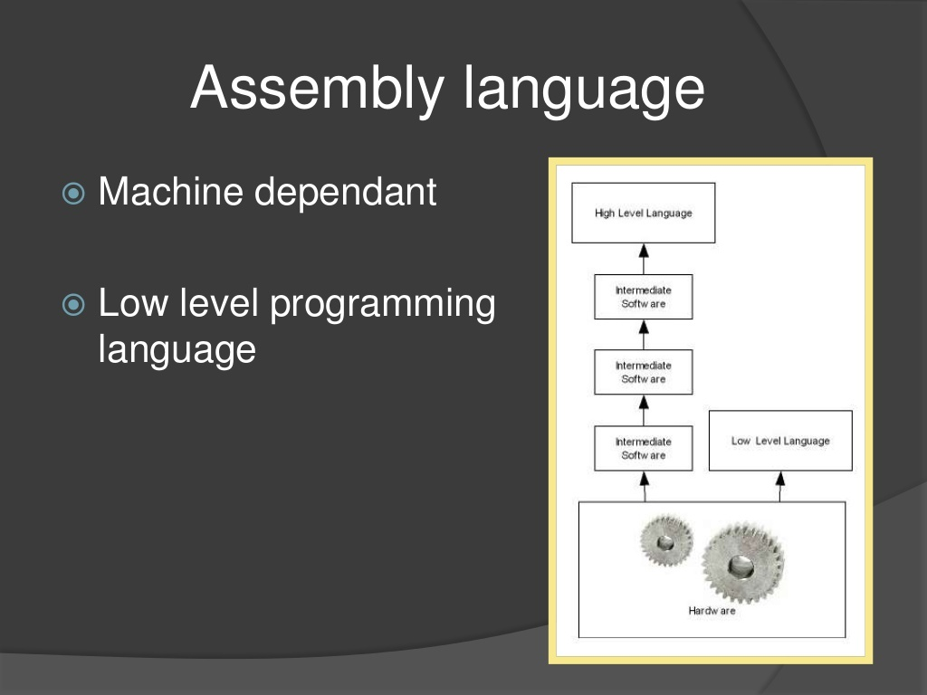

Slide 28
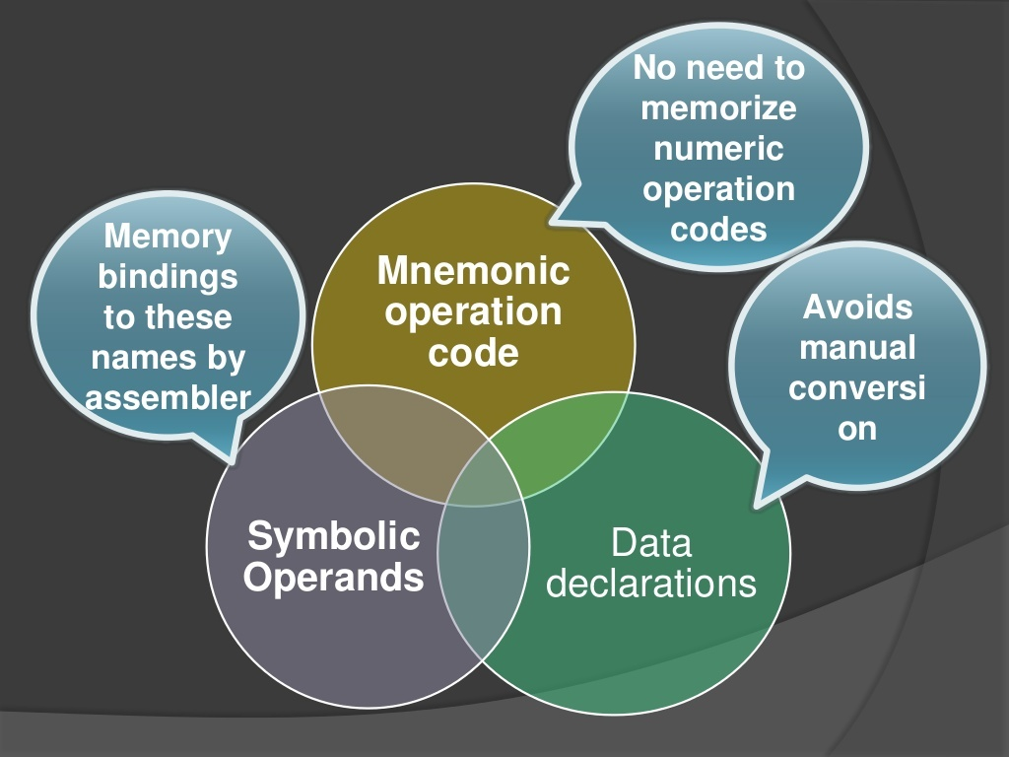
Elements Of ALP

Slide 29
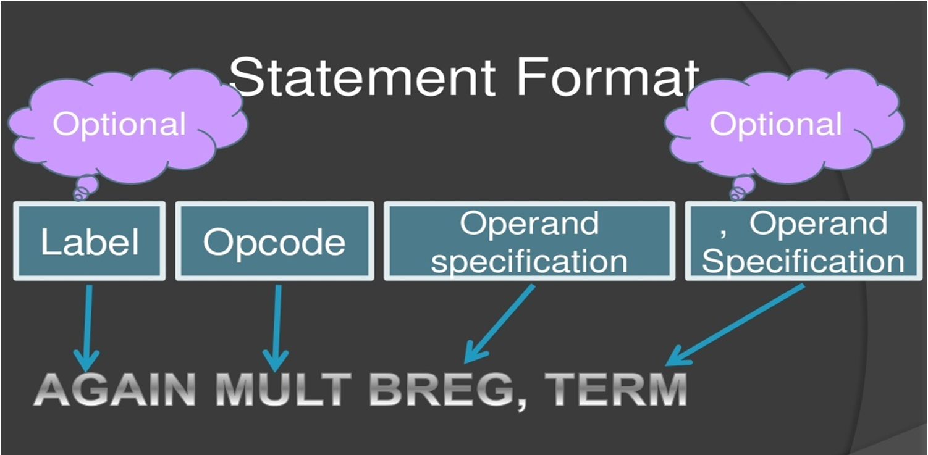

Slide 30
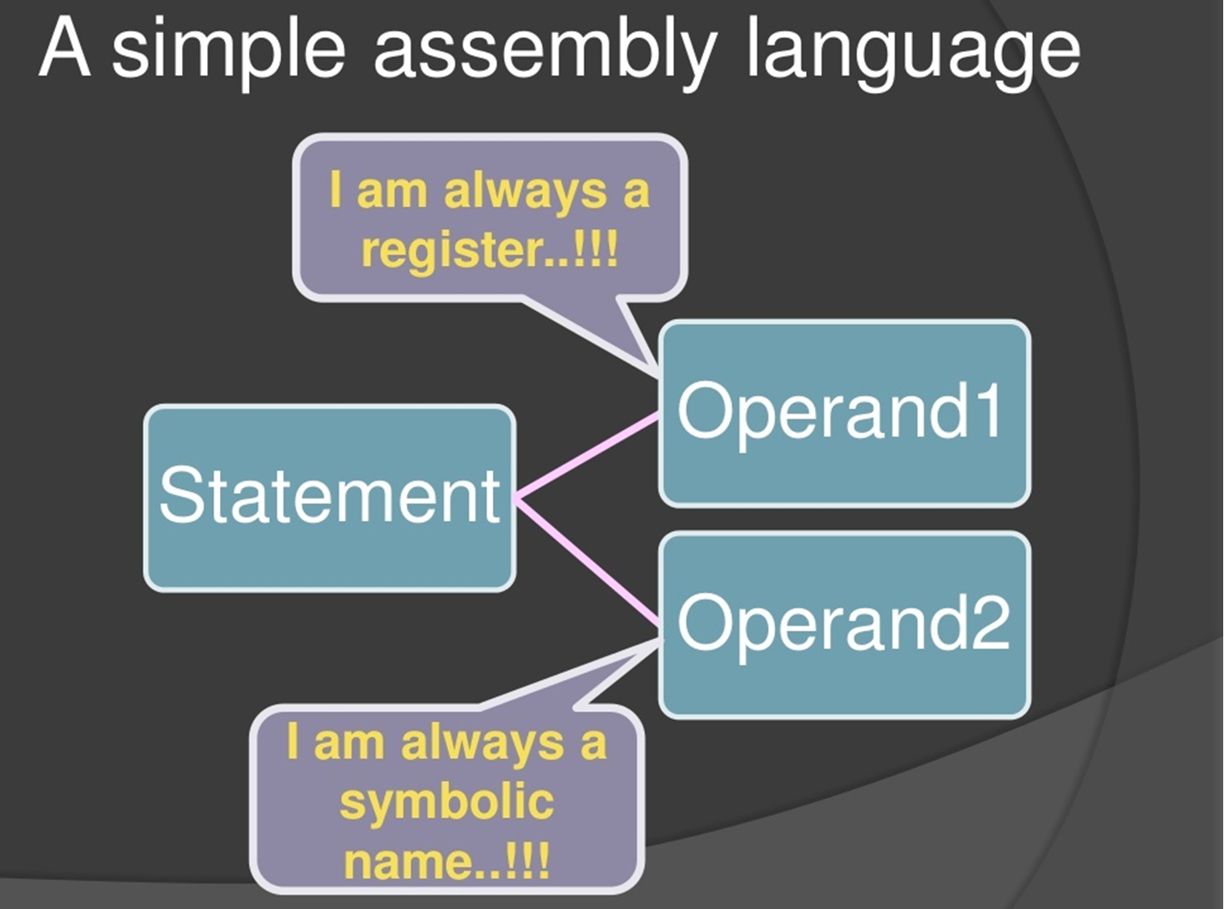

Slide 31
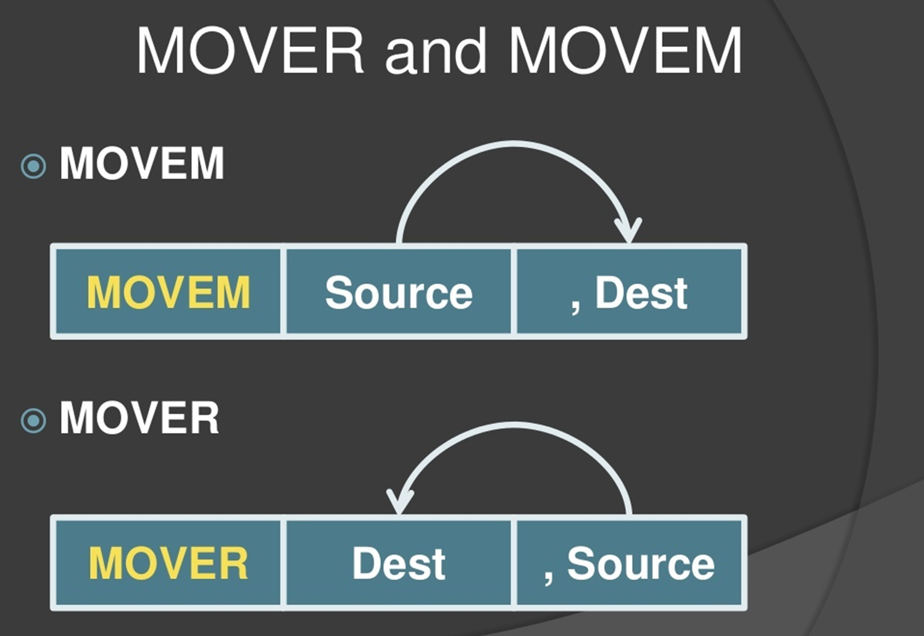

Slide 32
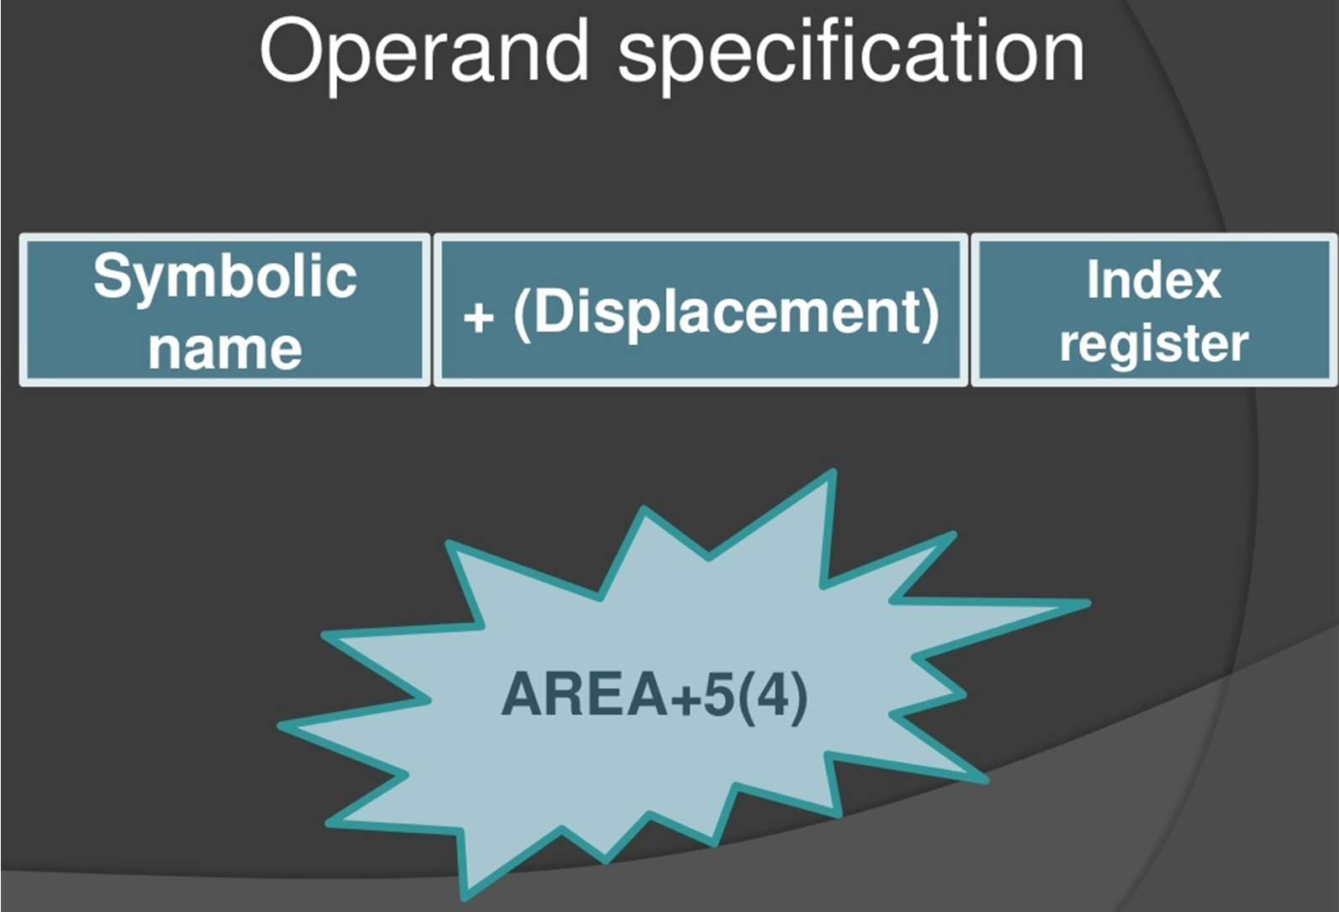

Slide 33
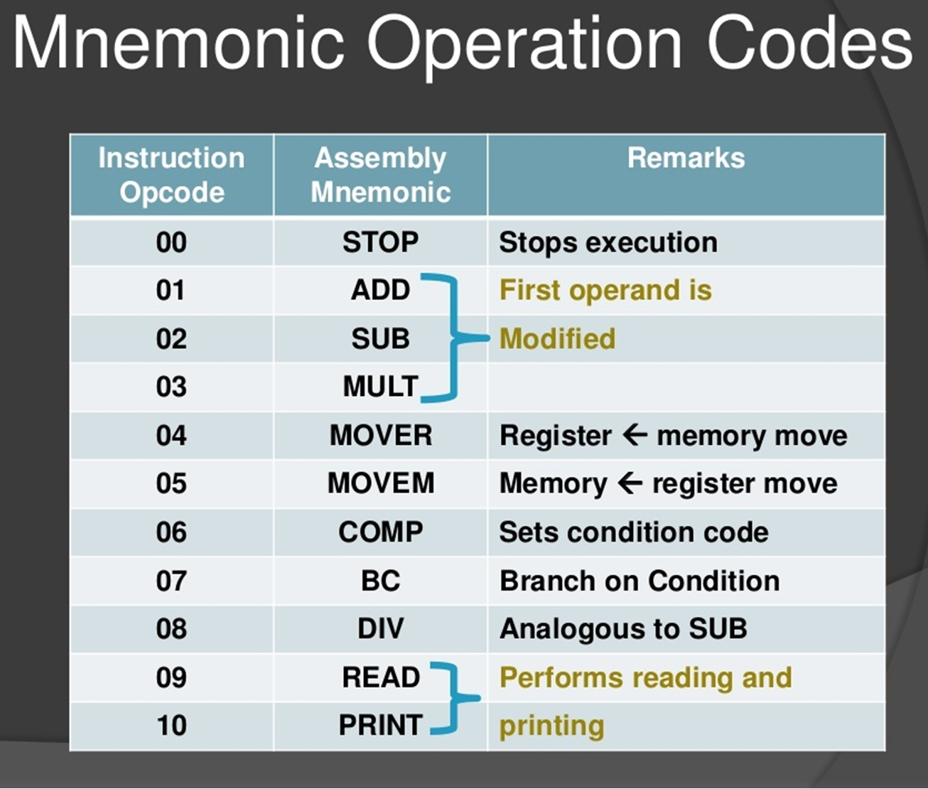

Slide 34
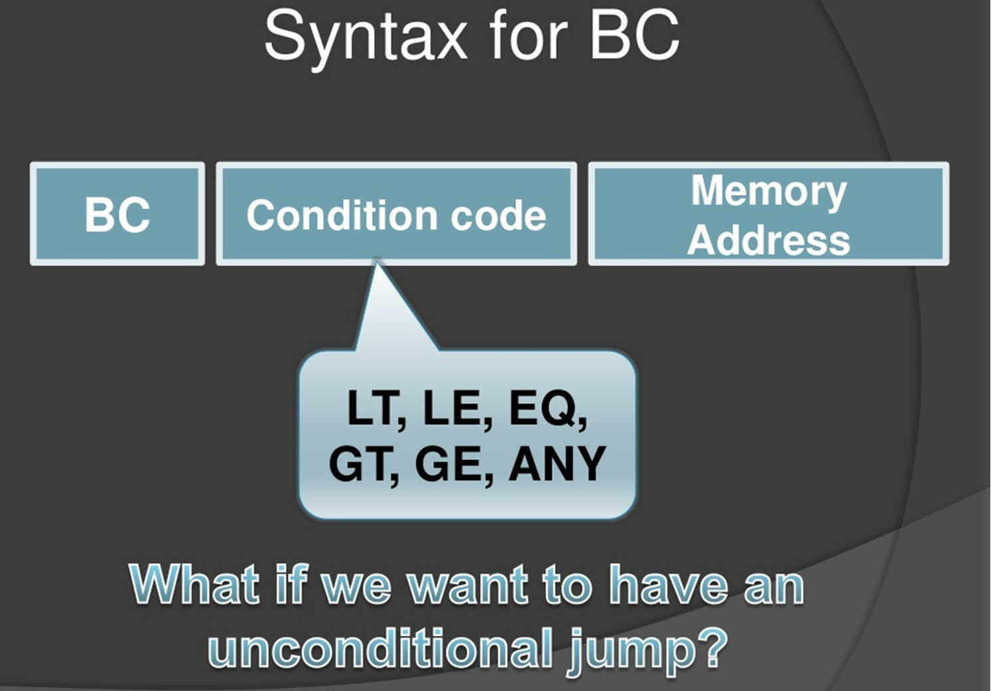

Slide 35
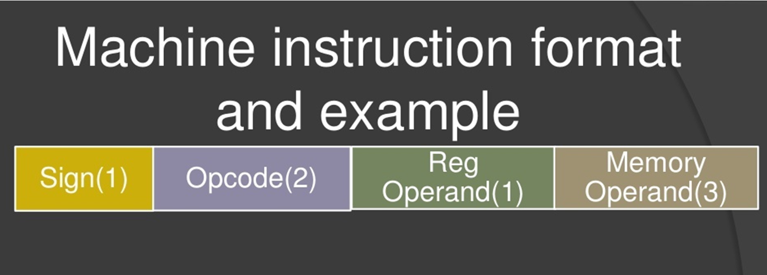

Slide 36
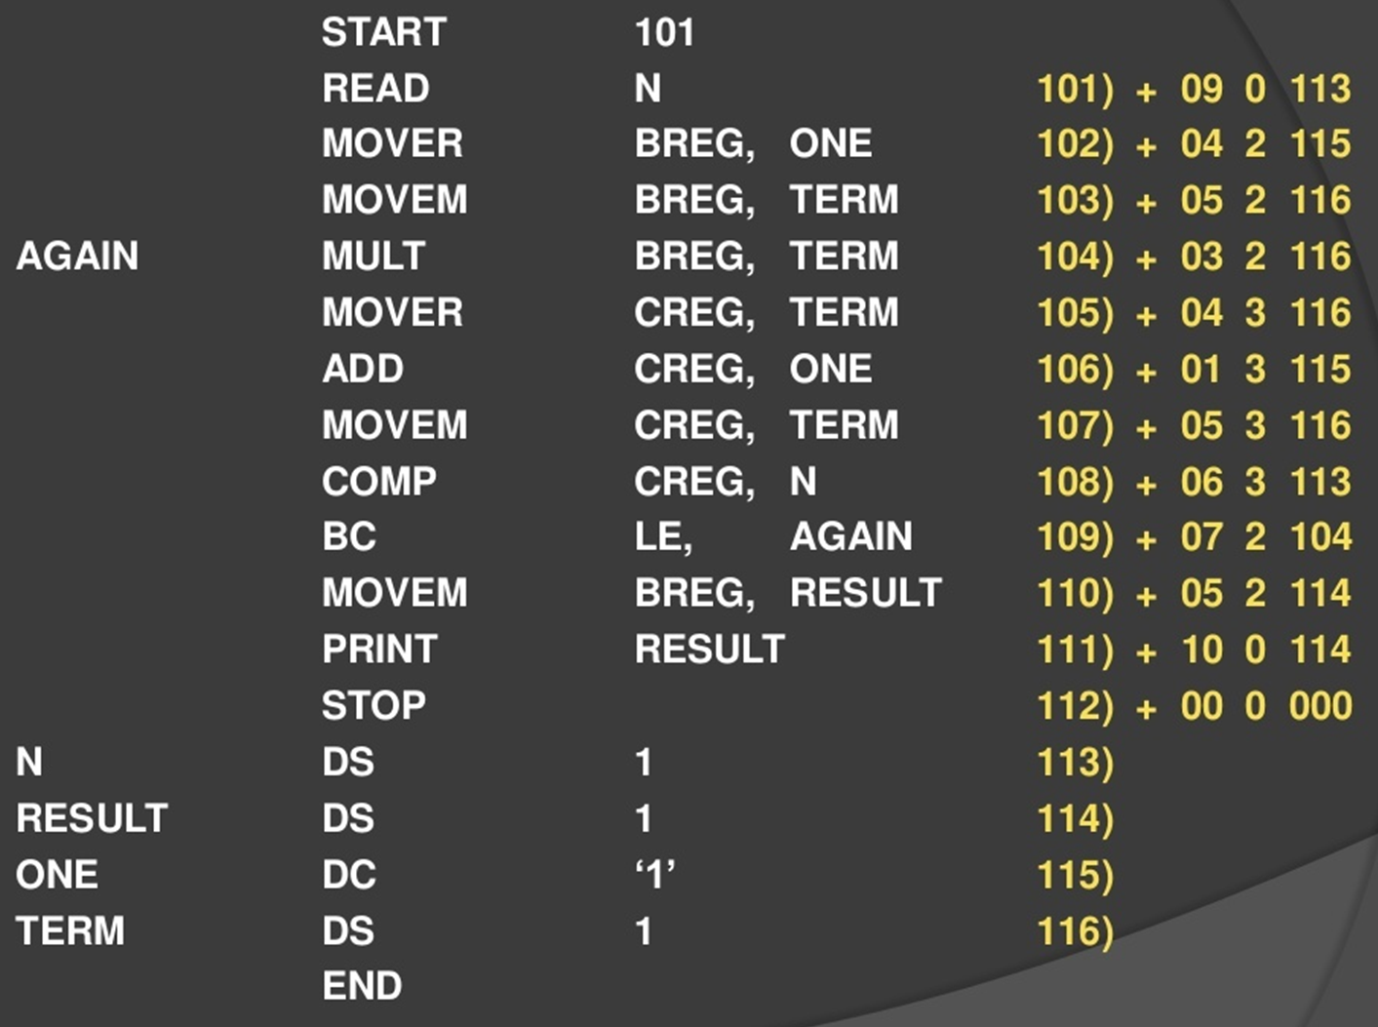
Example ALP and its equivalent MLP

Slide 37
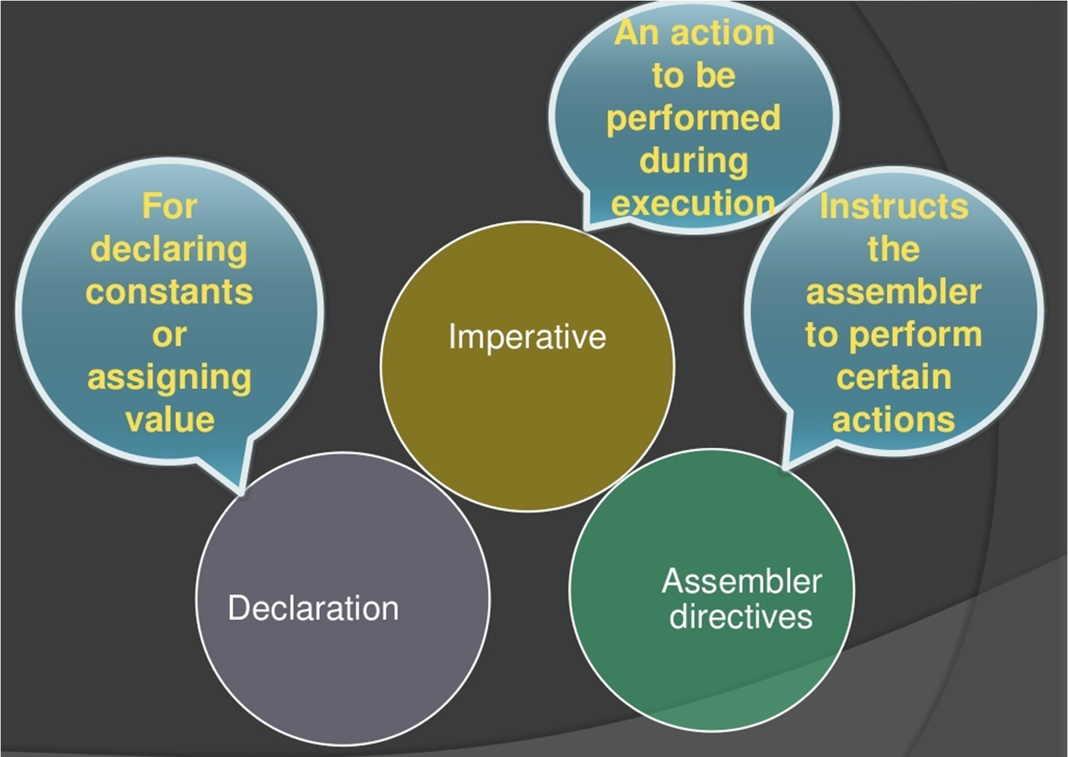
Statement Class for an ALP

Slide 38
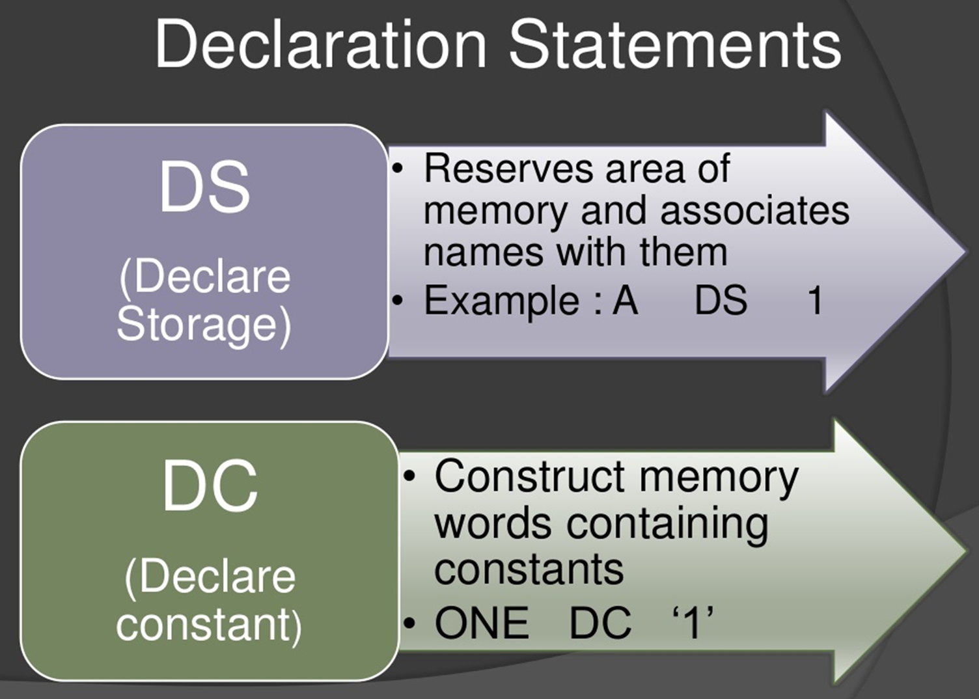

Slide 39
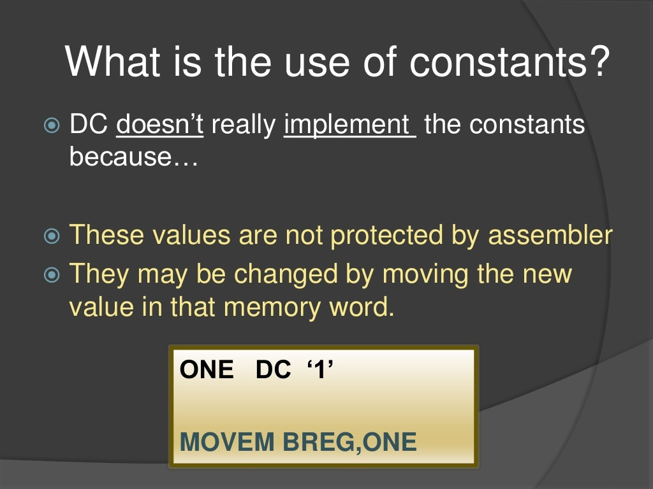

Slide 40
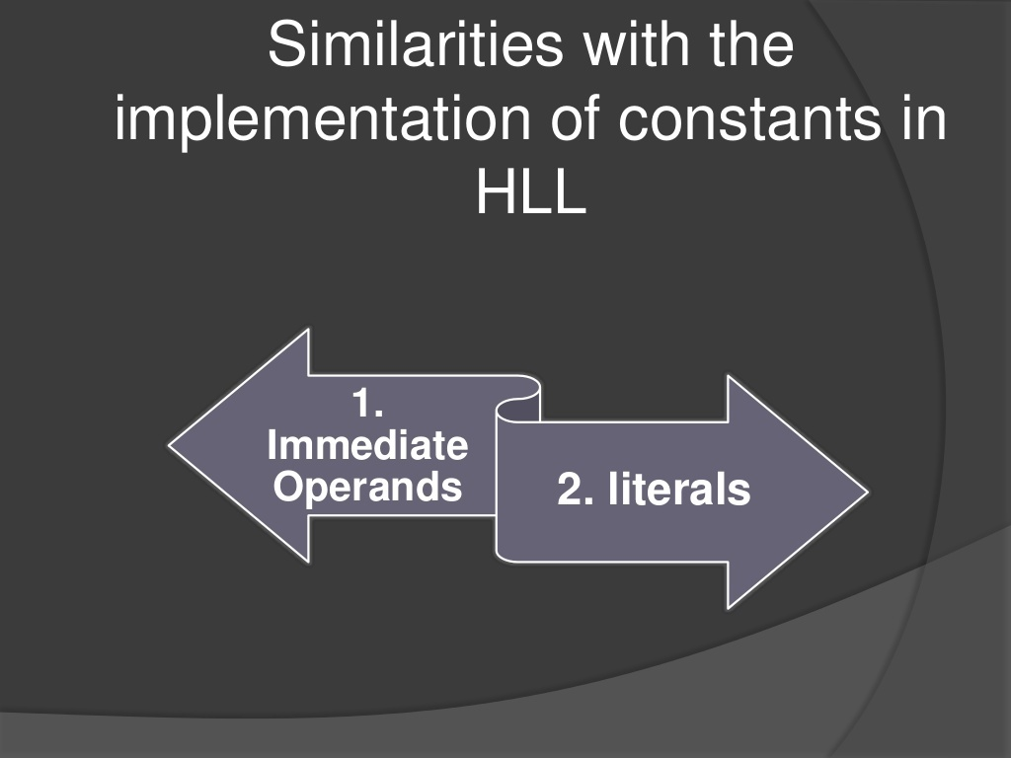

Slide 41
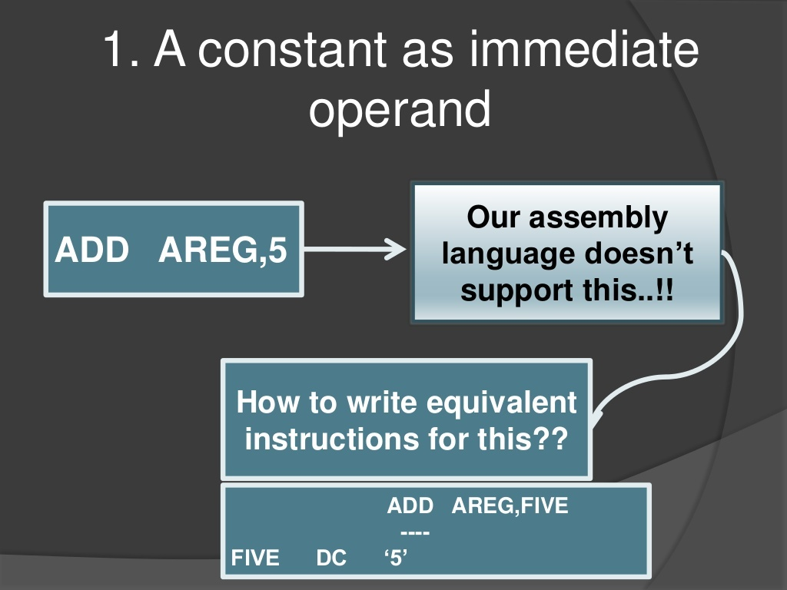

Slide 42
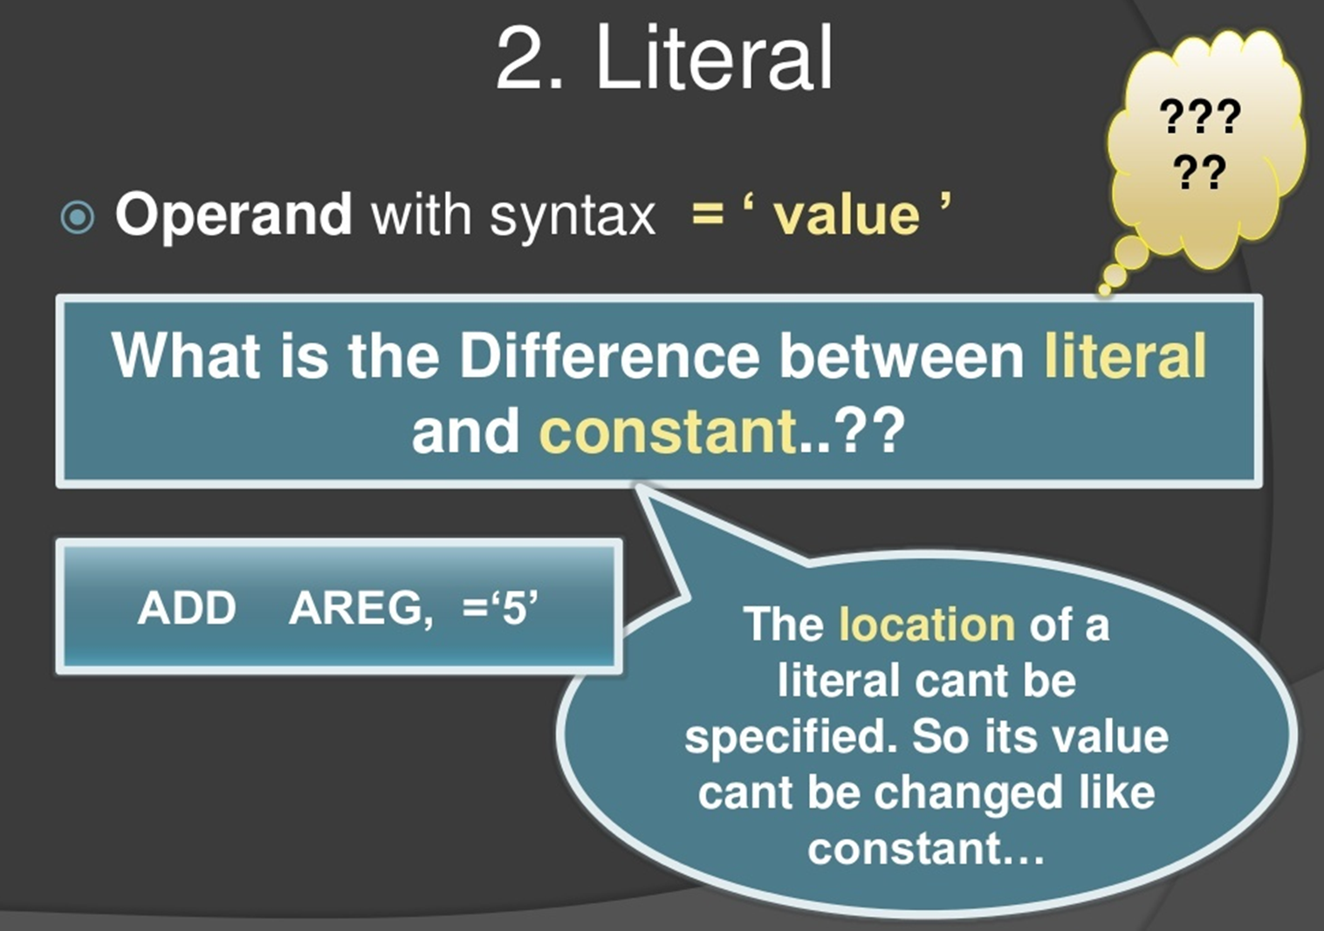

Slide 43
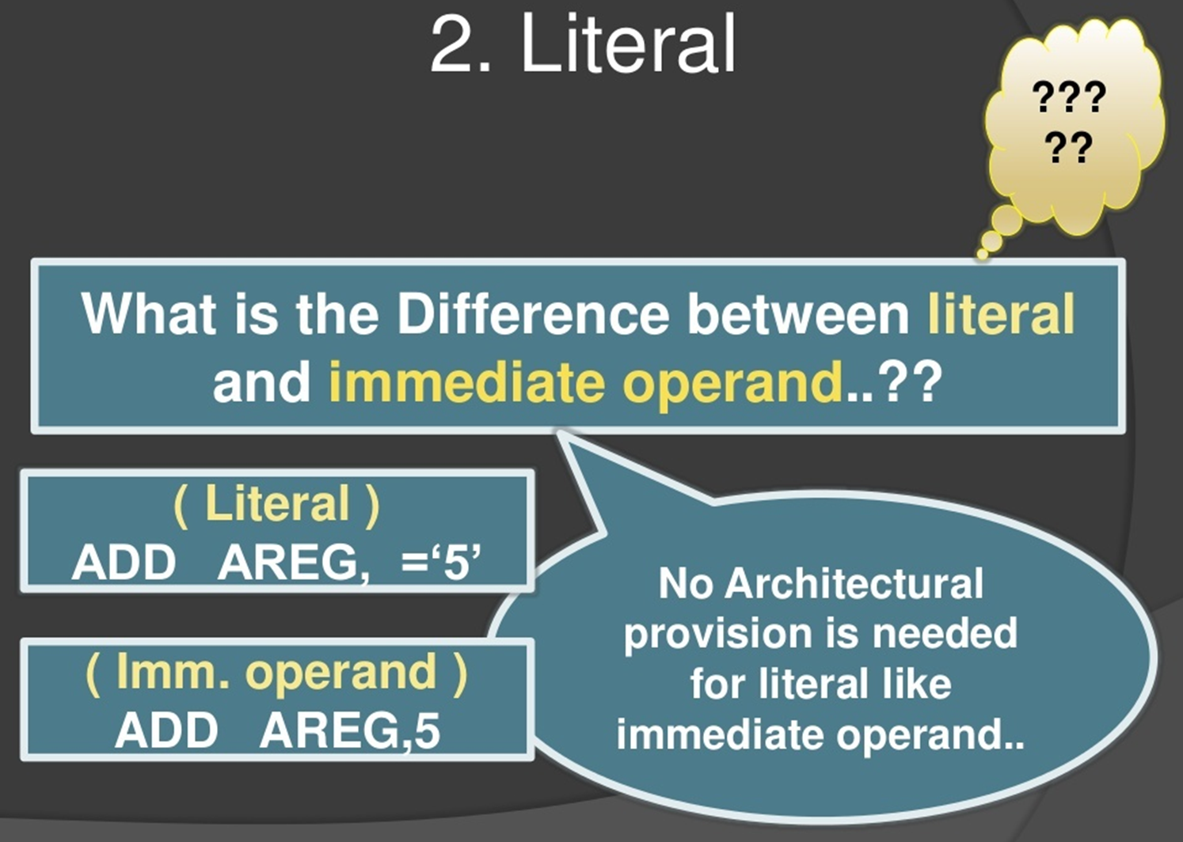

Slide 44
Difference between Literal and immediate operand
Literal is an assembler directive
Immediate is a machine recognizable data.
values are obtained from data memory
Immediate data is within the instructions itself
Eg.
MOV R1, 17 ; mov 17 to reg r1
DW 17 ; define a word containing the literal 17

Slide 45
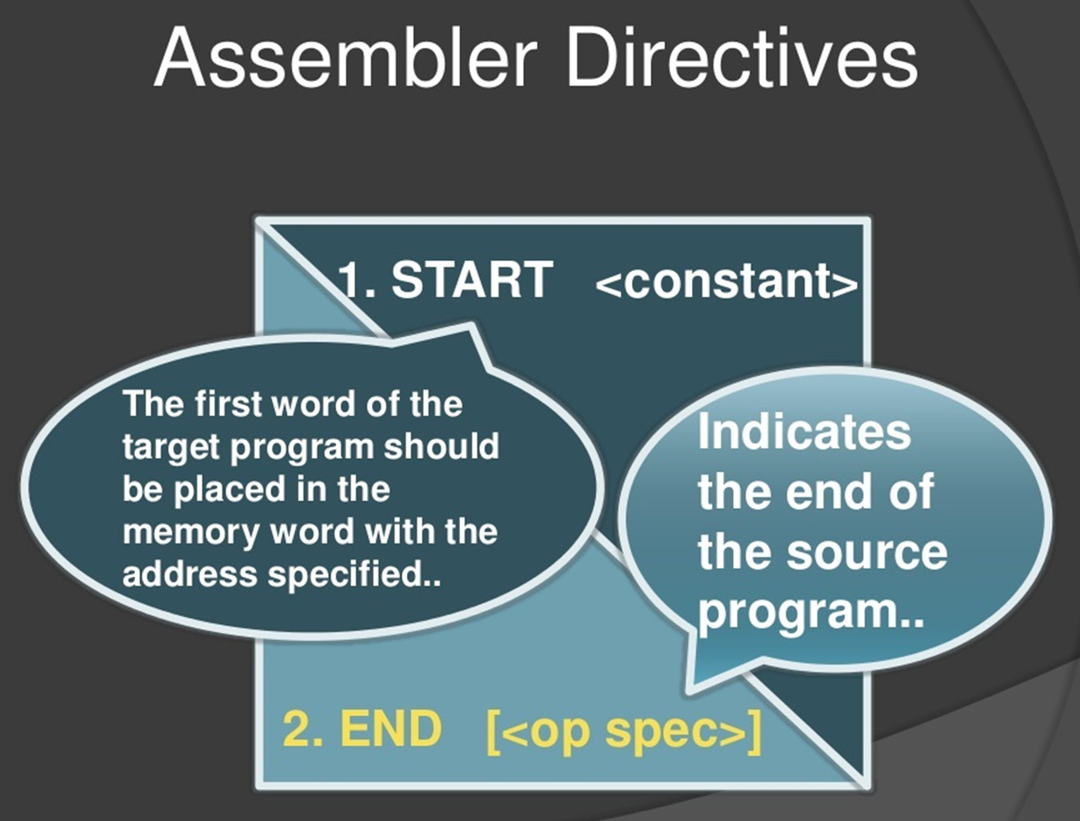

Slide 46
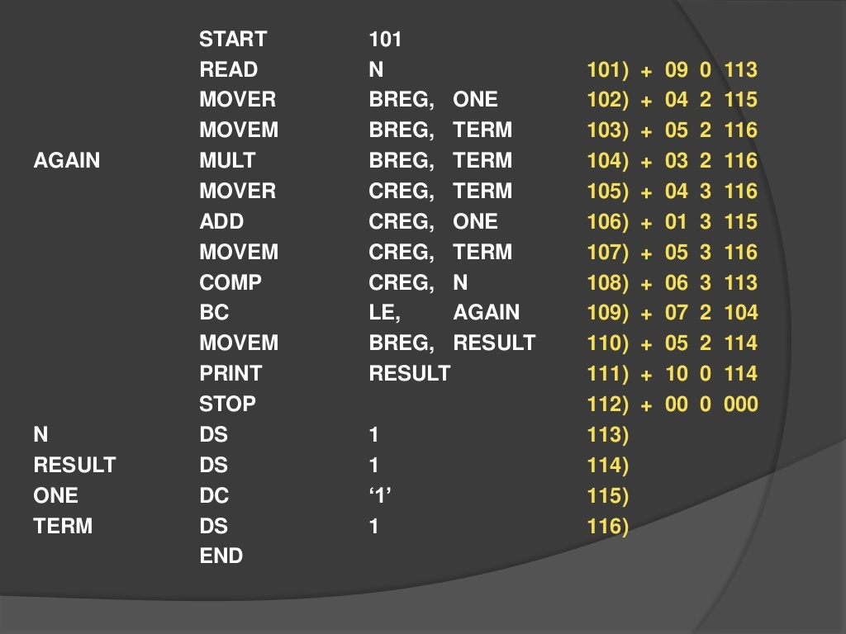
Sample Assembly Language Program with its Machine Translation

Slide 47
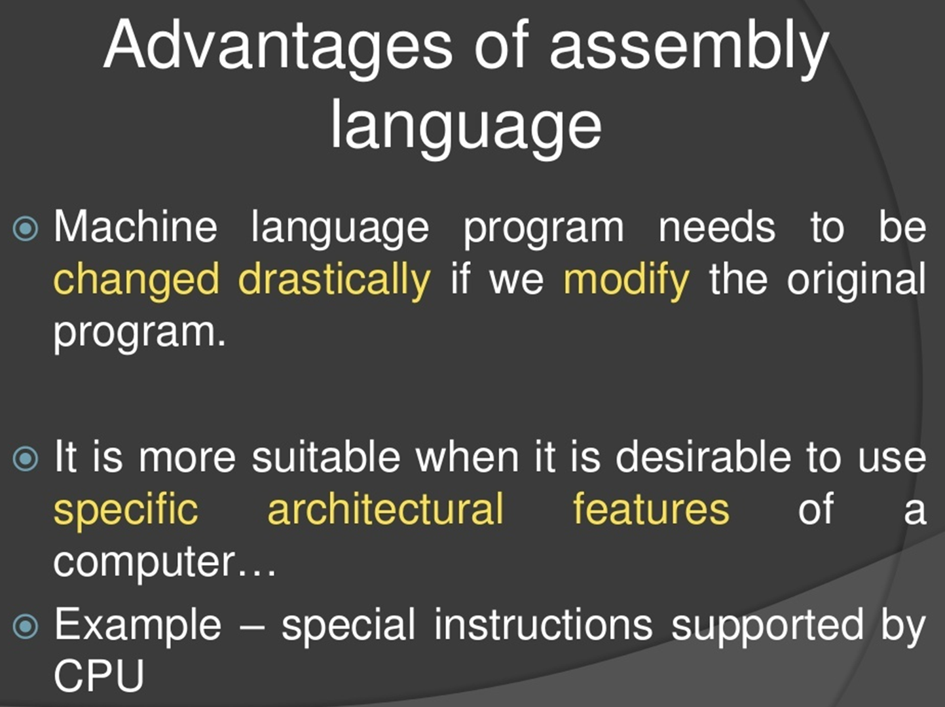

Slide 48
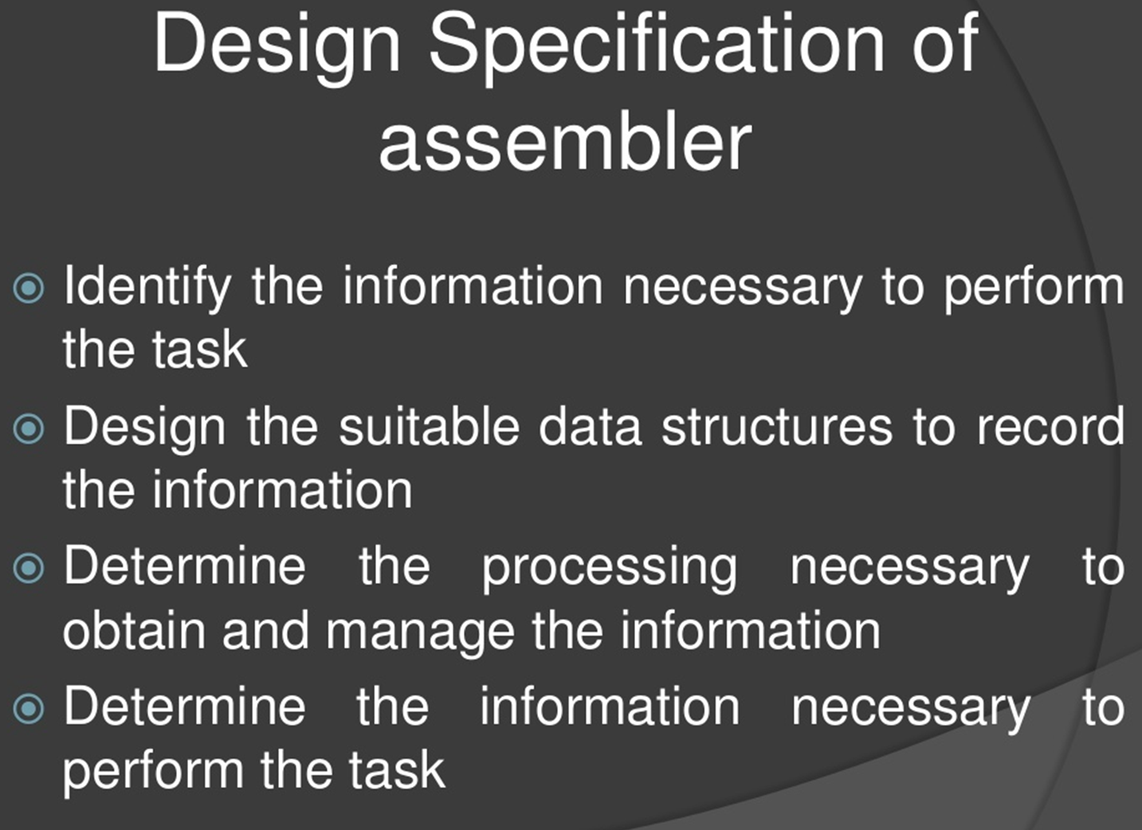

Slide 49
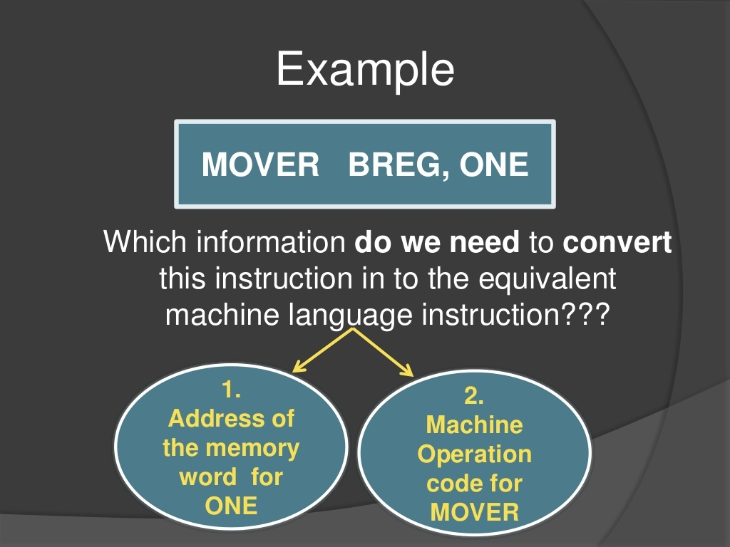

Slide 50
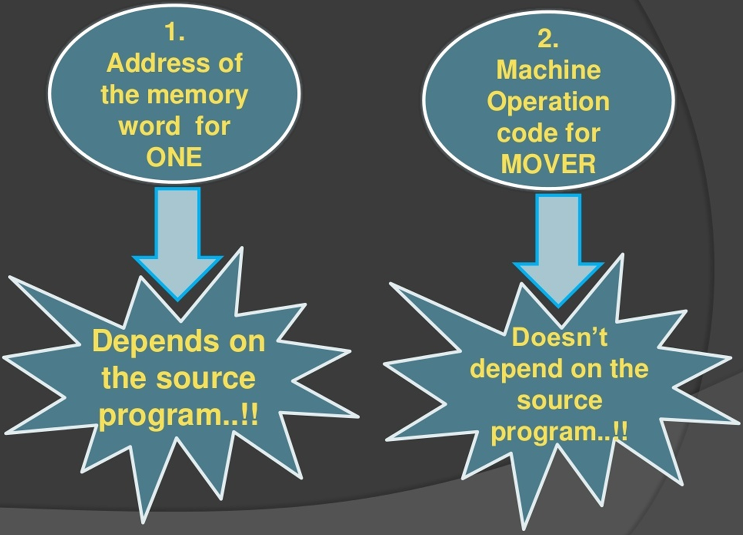

Slide 51
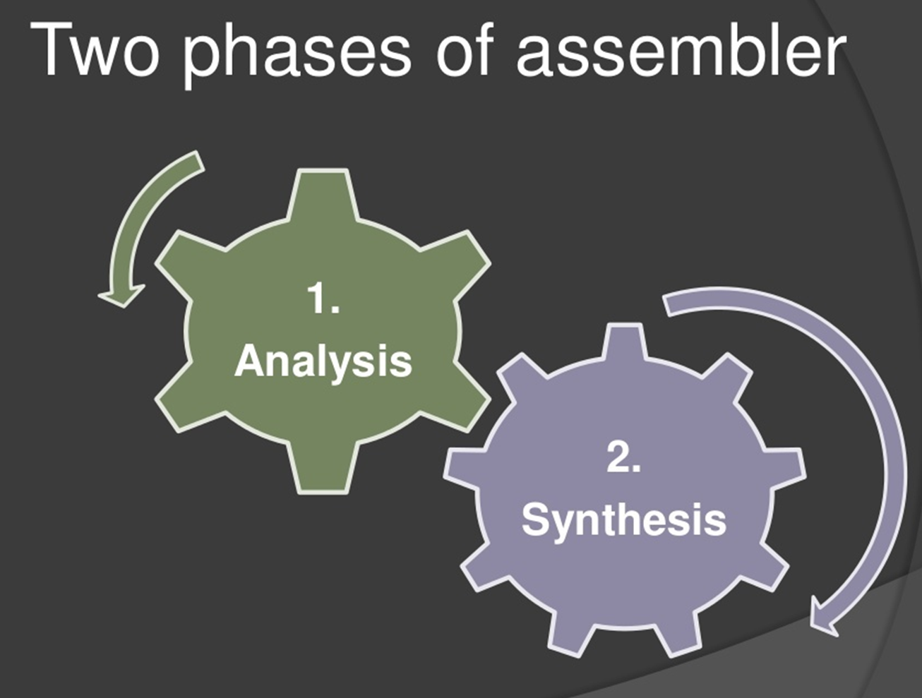

Slide 52
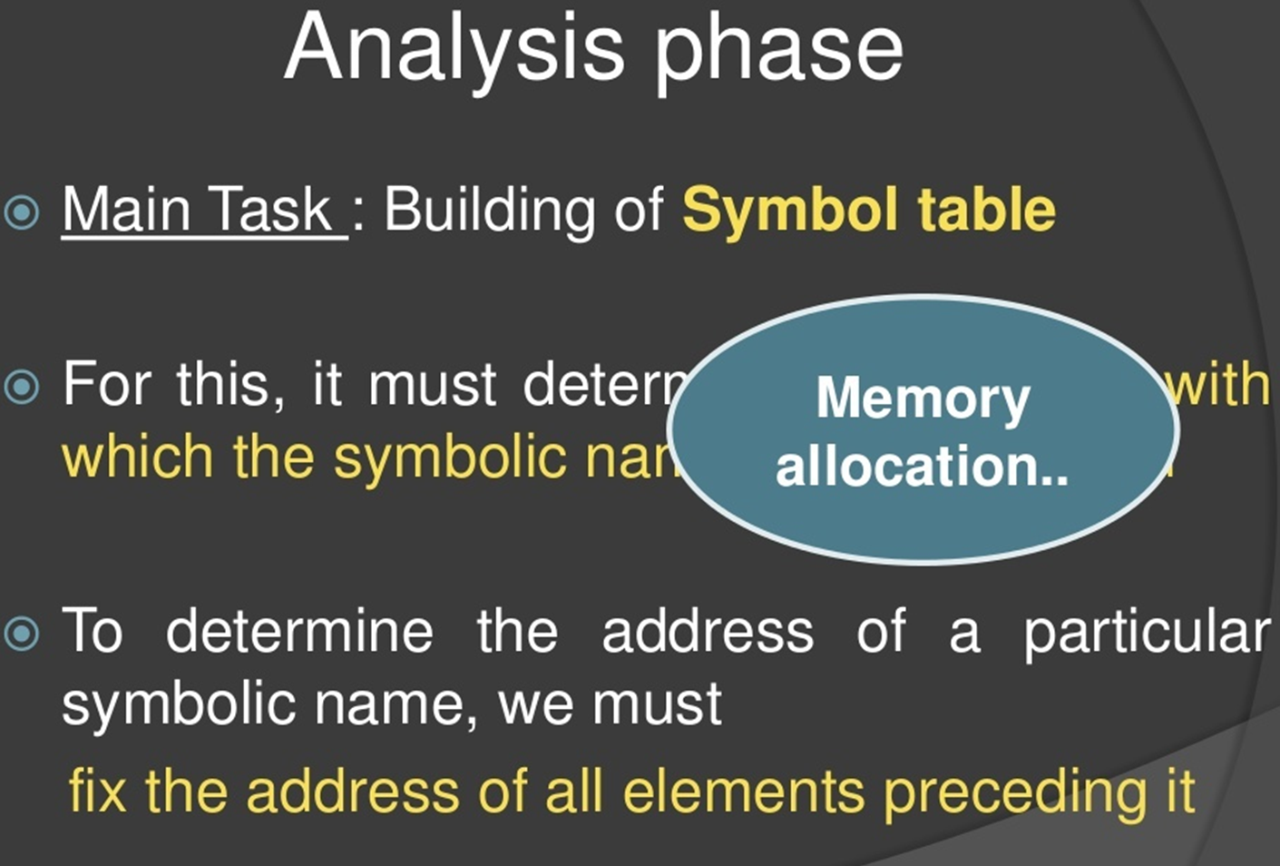

Slide 53
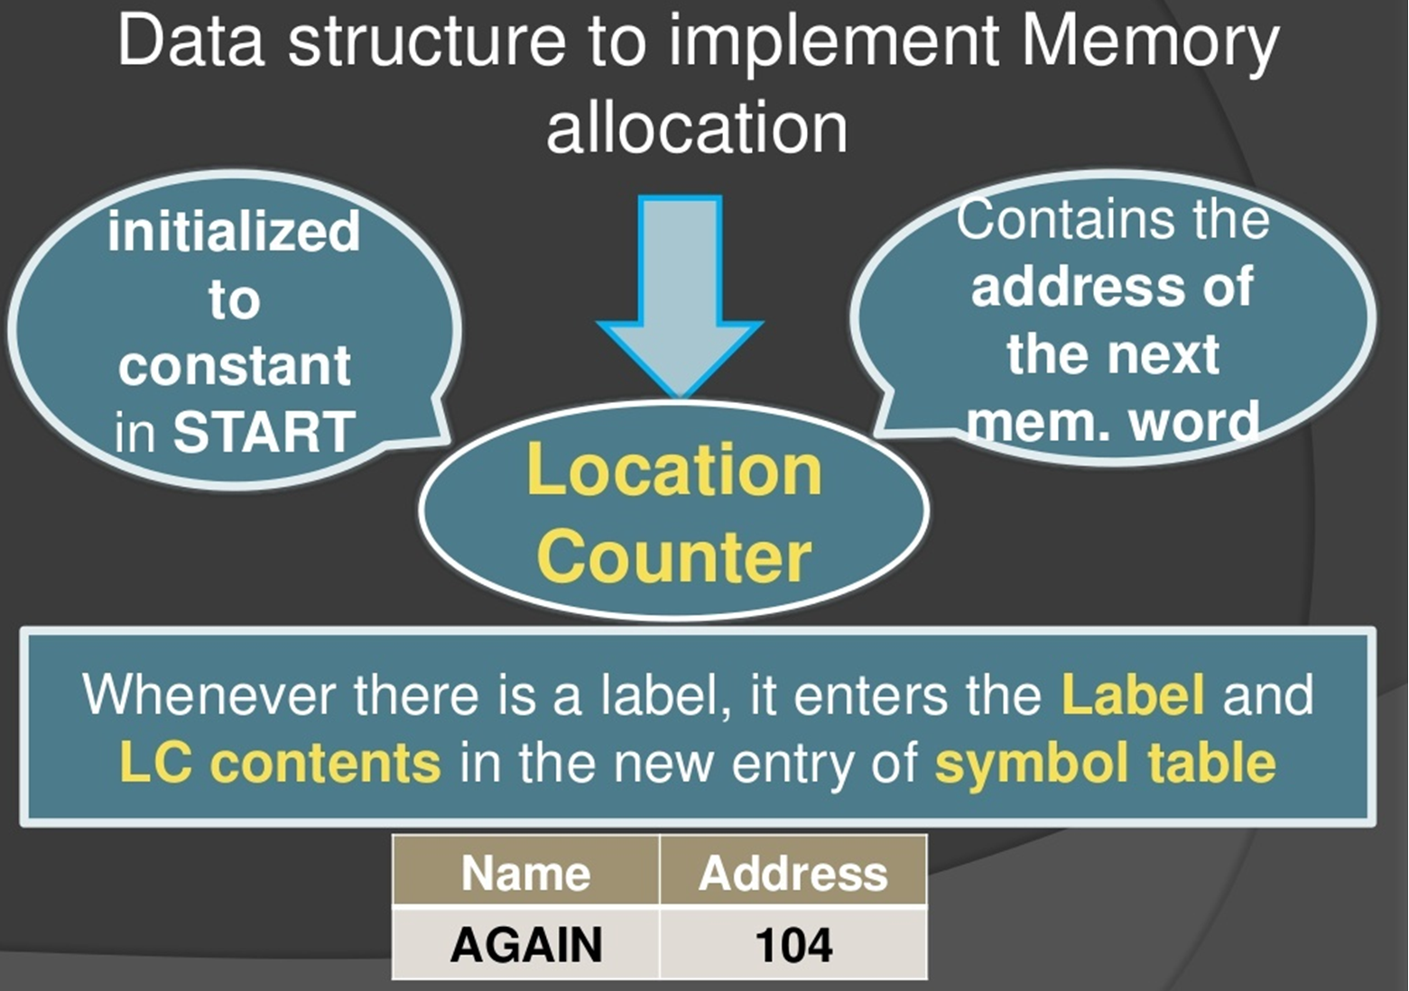

Slide 54
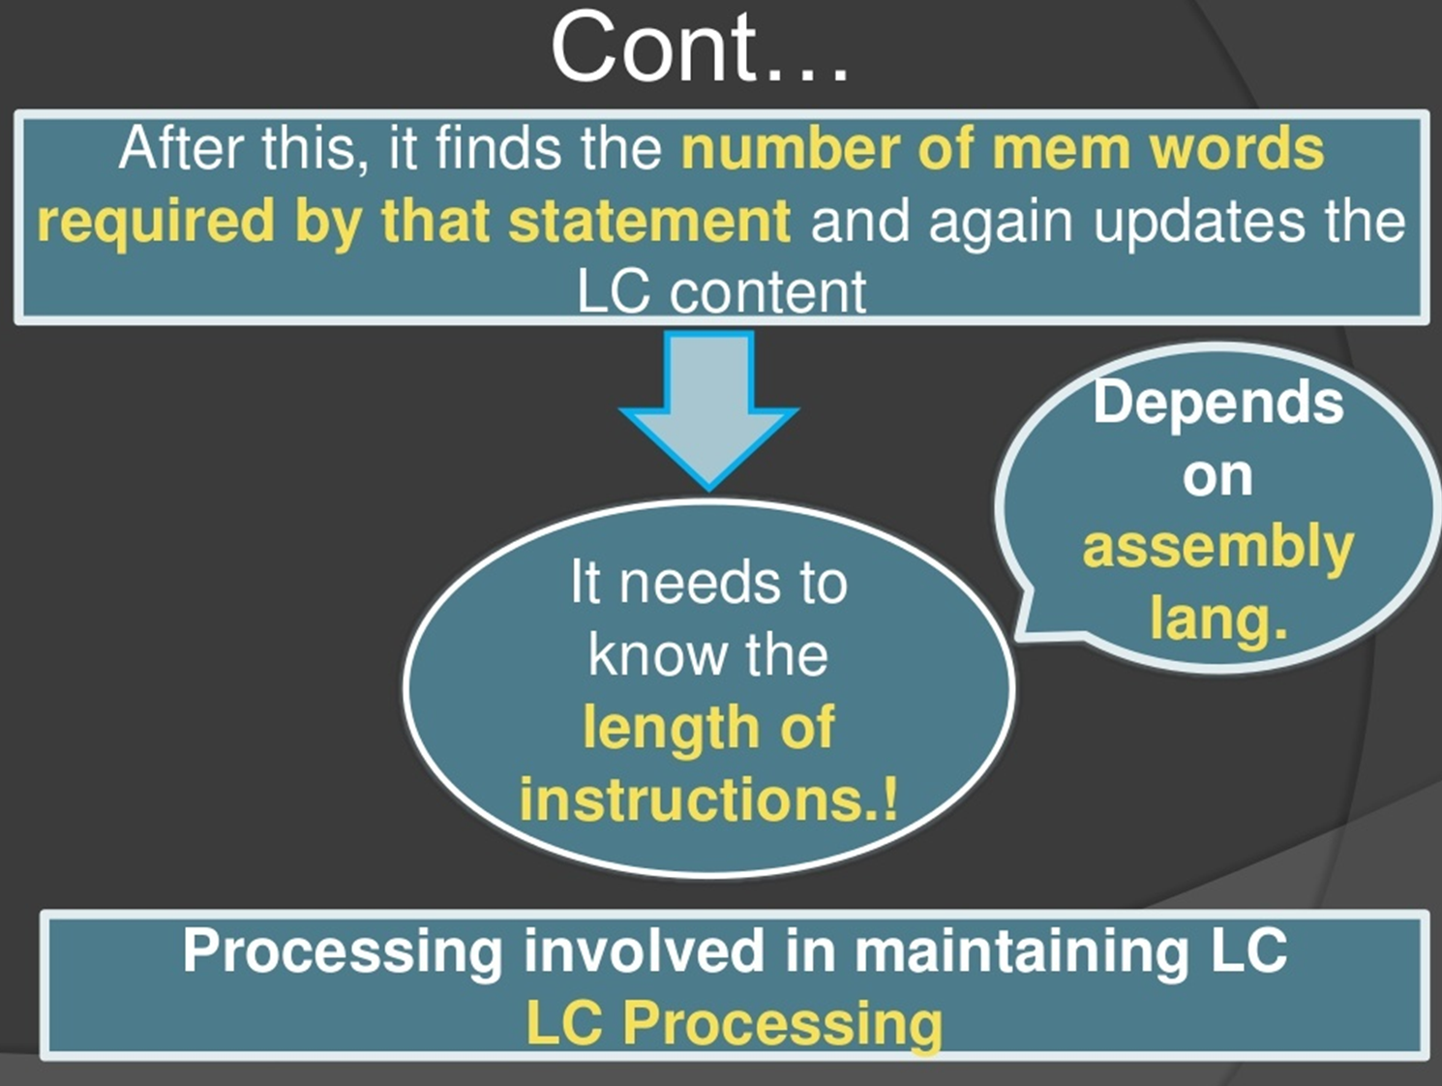

Slide 55
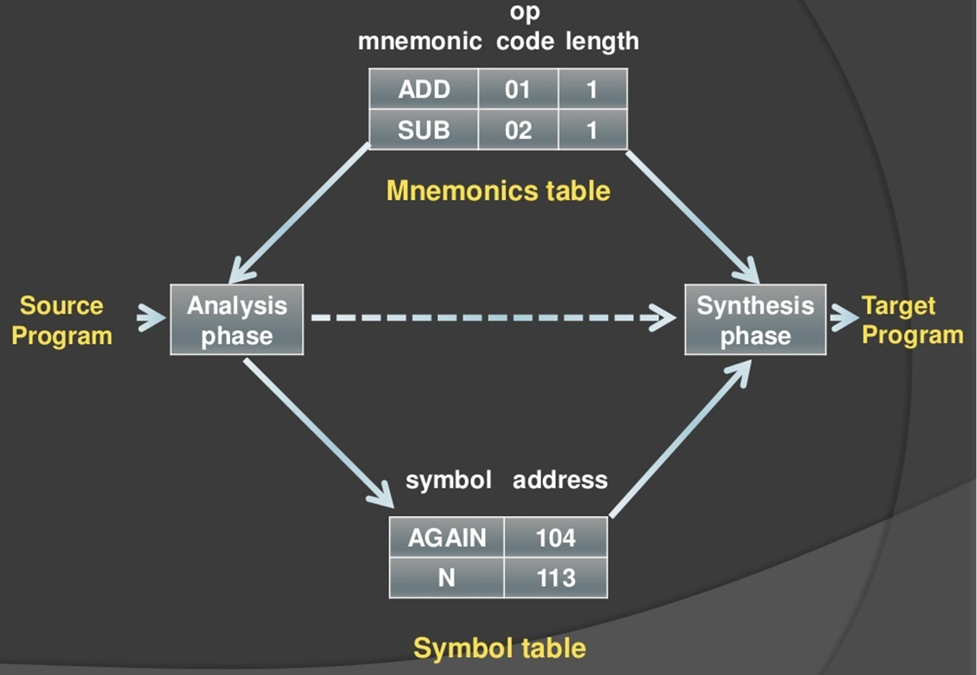
Data Structures For Assembler
OPTAB

Slide 56
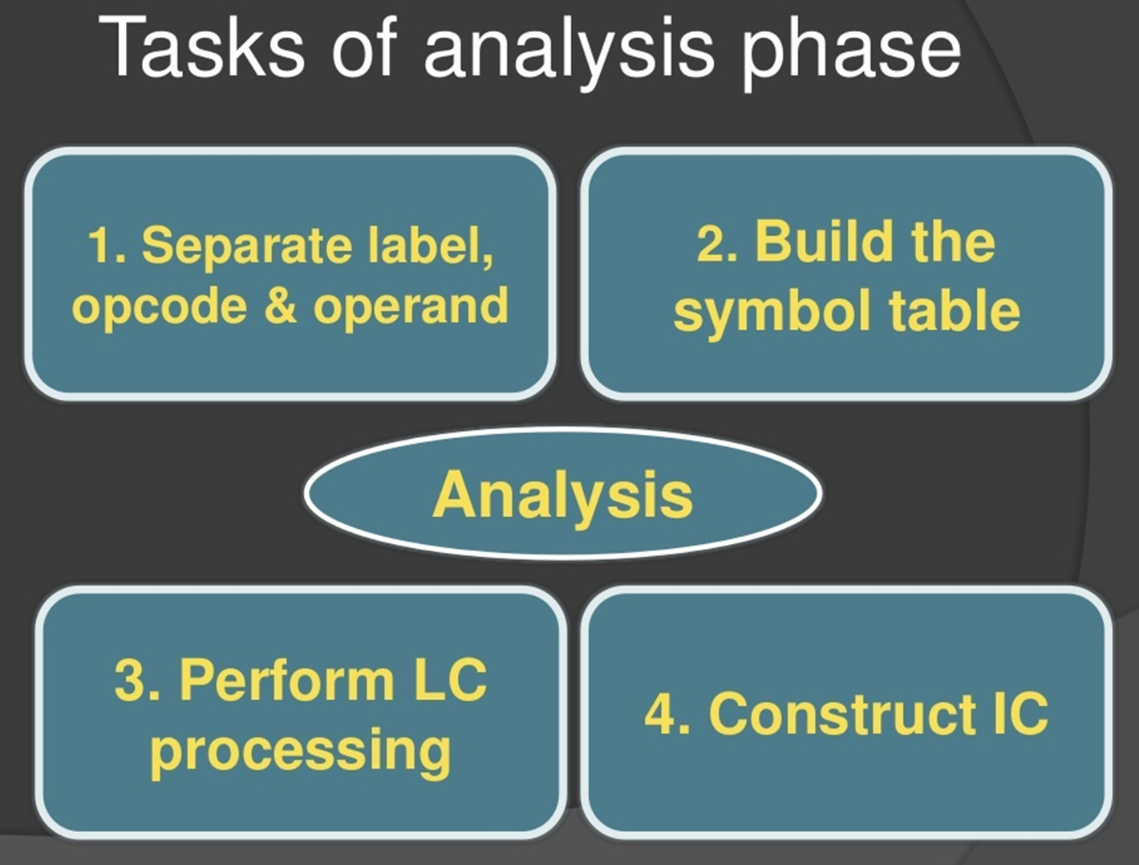

Slide 57
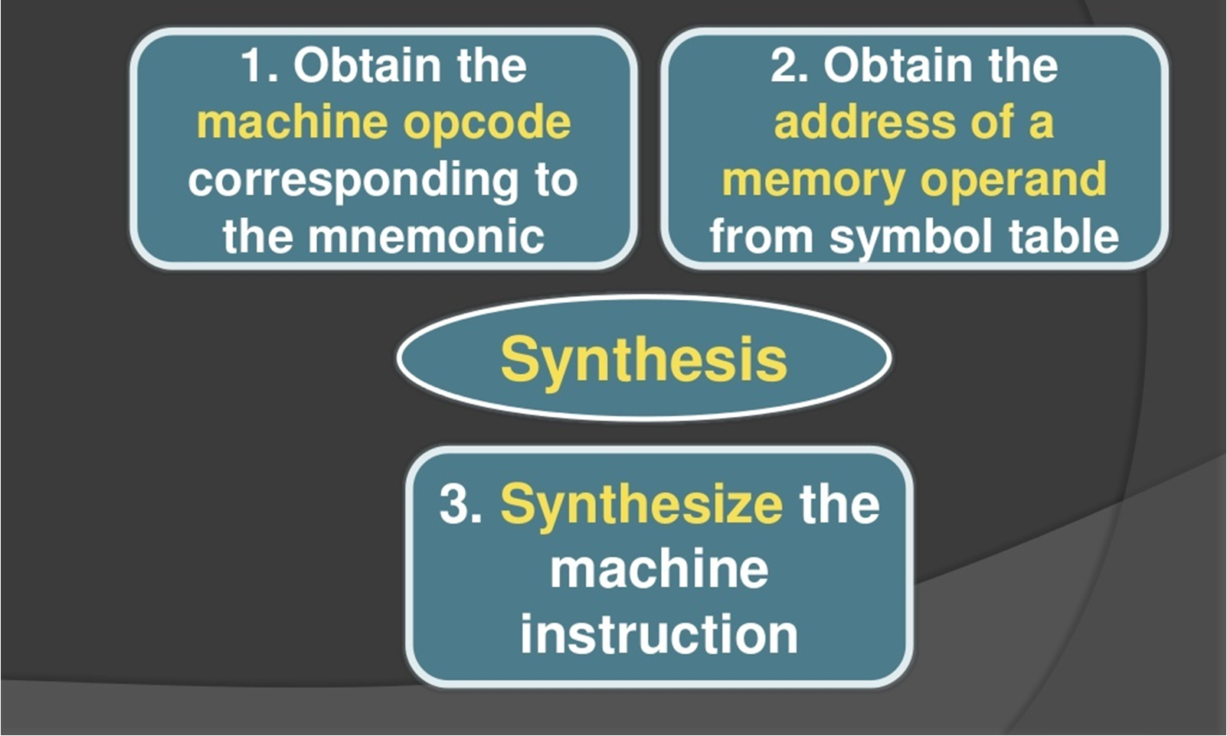
Tasks of Synthesis Phase

Slide 58
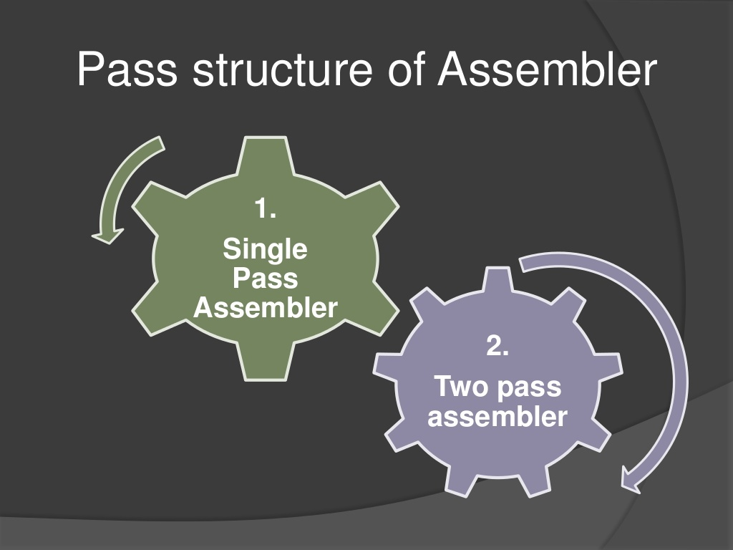

Slide 59
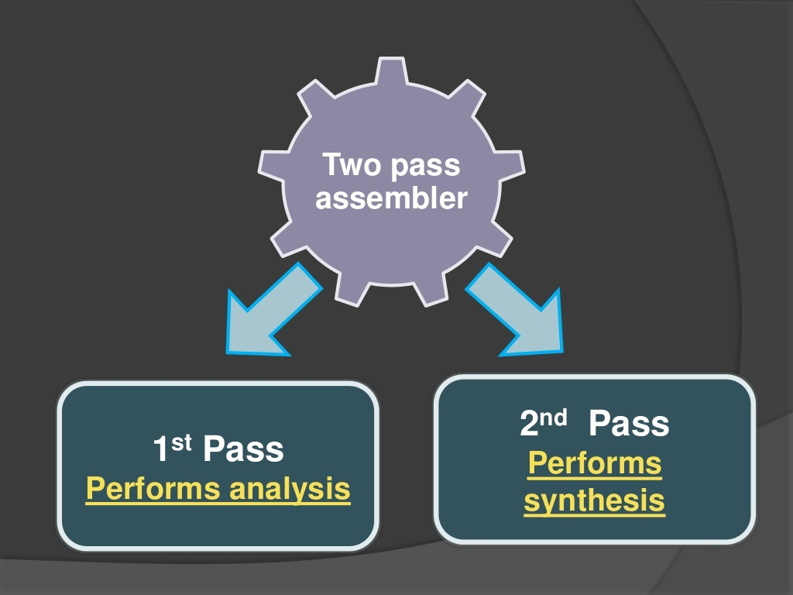

Slide 60
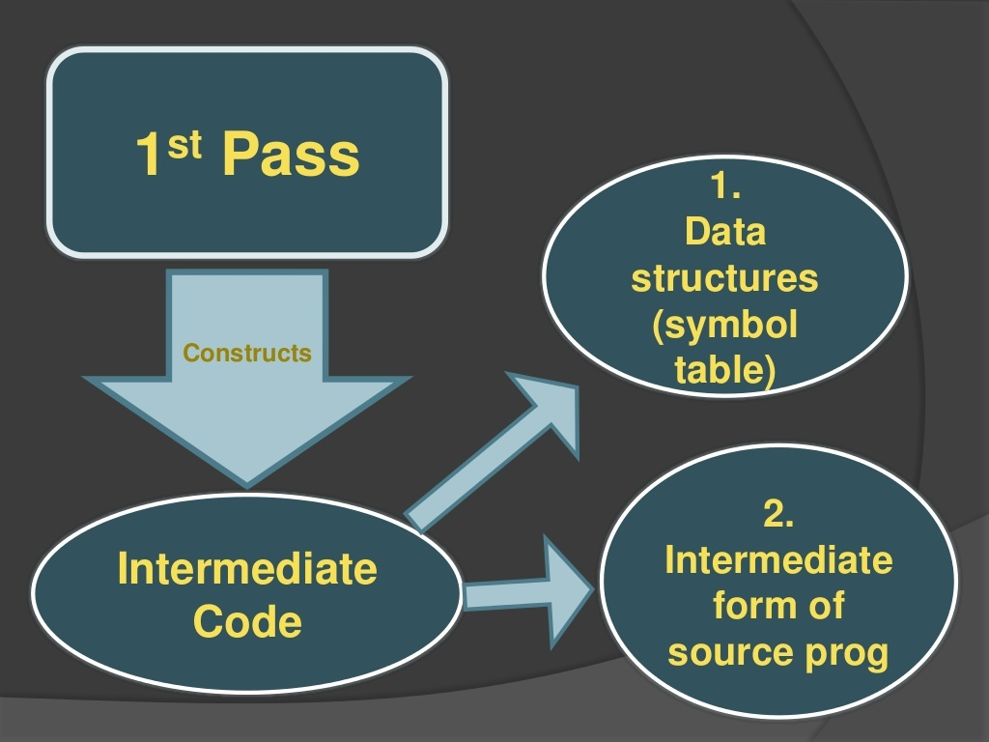

Slide 61
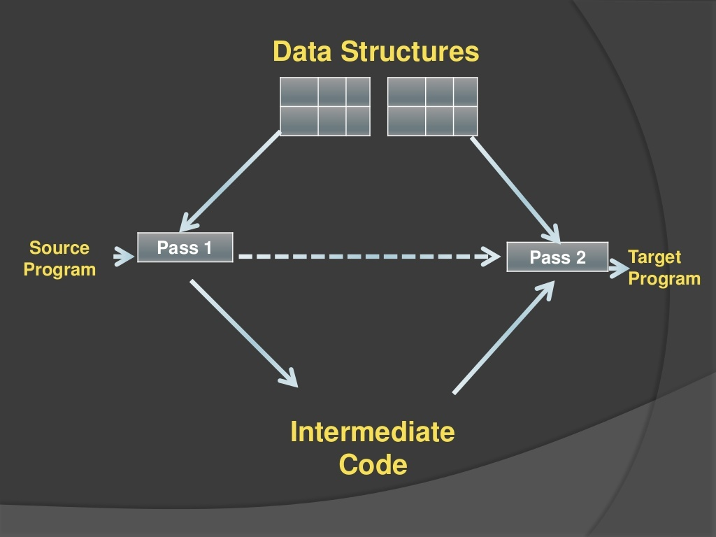

Slide 62
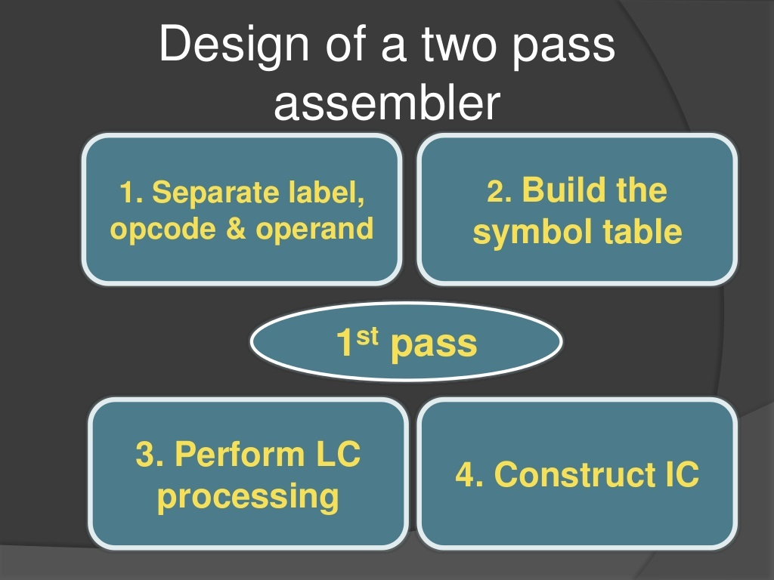

Slide 63
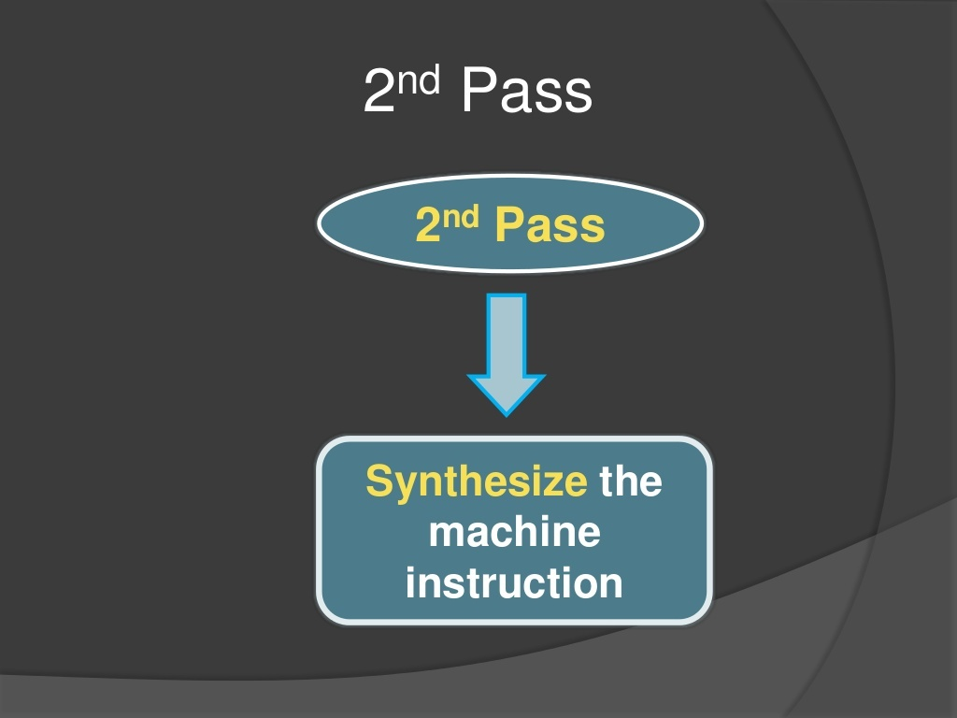

Slide 64
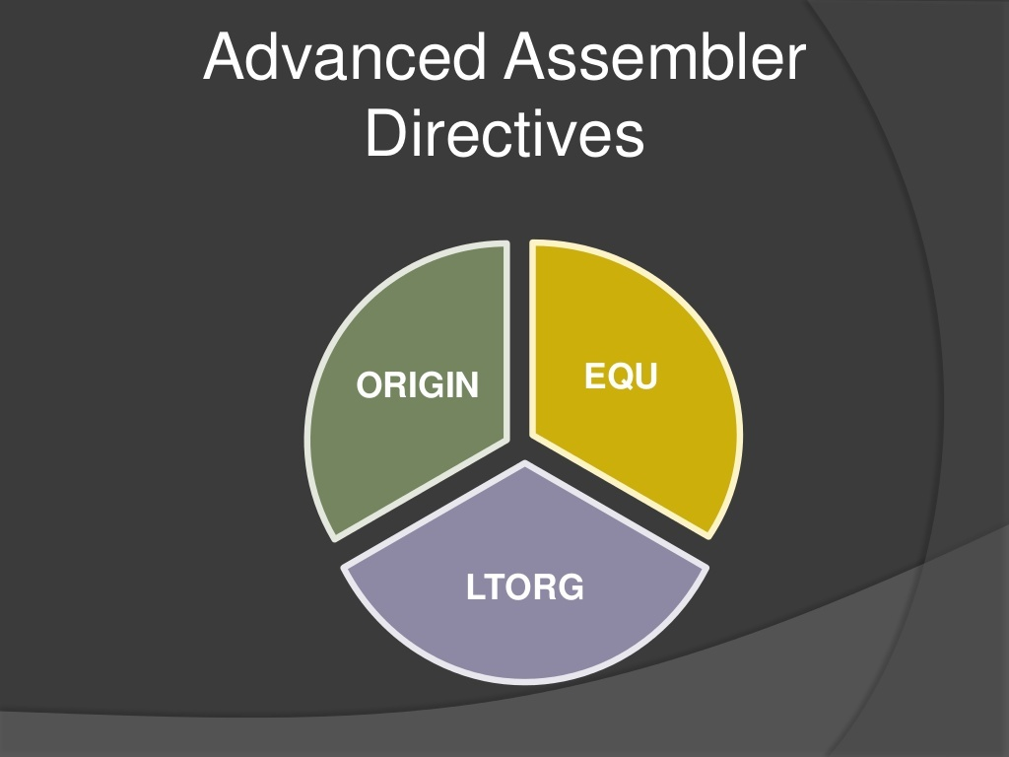

Slide 65
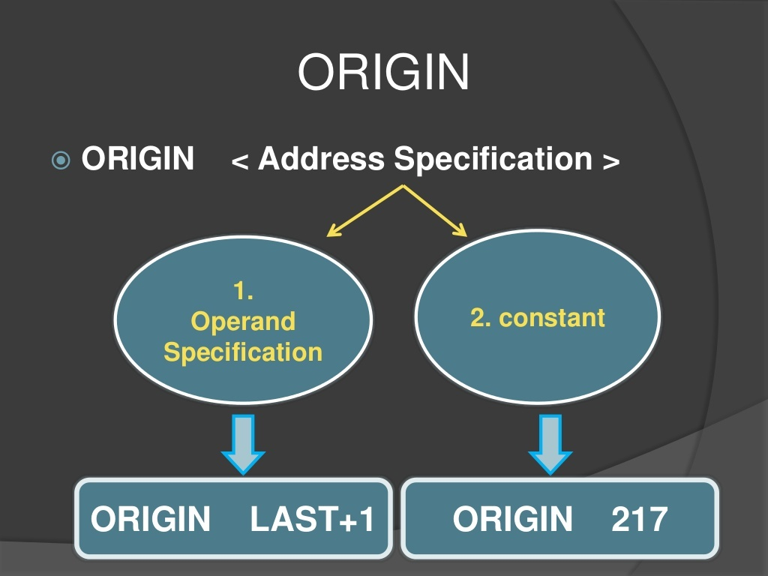

Slide 66
ORIGIN :The origin directive tells the assembler where to load instructions and data into memory.
Syntax : ORIGIN < address spec> < address spec>
can be an or constant Indicates that Location counter should be set to the address given by < address spec>
This statement is useful when the target program does not consist of consecutive memory words.
Eg. ORIGIN Loop + 2

Slide 67
ORG
The ORG instruction alters the setting of the location counter and thus controls the structure of the current control section.
The origin directive tells the assembler where to load instructions and data into memory.
It changes the program counter to the value specified by the expression in the operand field.
Subsequent statements are assembled into memory locations starting with the new program/location counter value.
If no ORG directive is encountered in a source program, the program counter is initialized to zero.
Assembler uses an internal variable called LC (Location Counter) to store current offset address of the statement being processed.
When it encounters a variable declaration statement, it puts the value of LC in its symbol table as variable’s address.

Slide 68
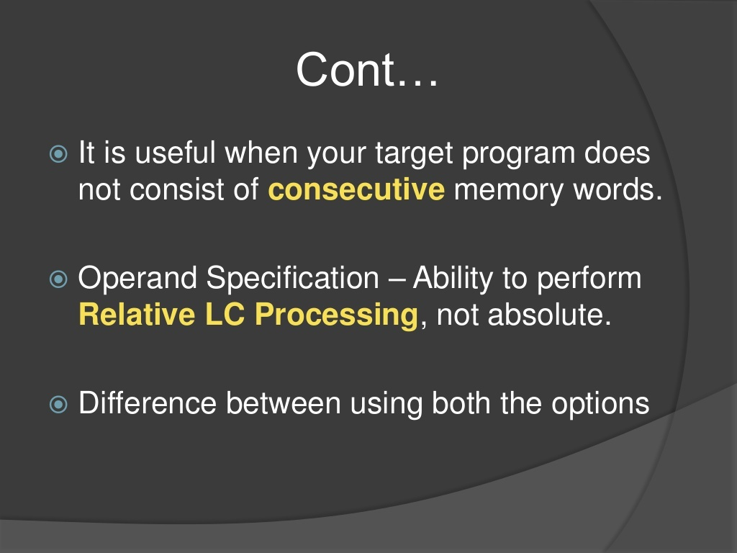

Slide 69
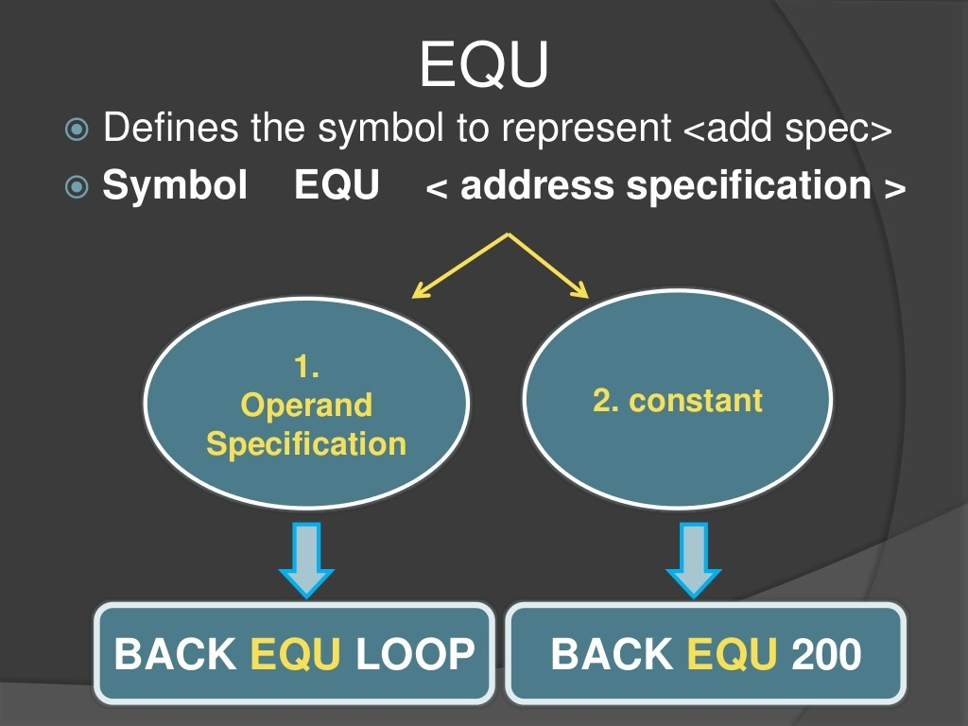

Slide 70
EQU : It is used for making program more readable. Whenever symbol define with EQU statement no memory would be allocated only an entry would make in symbol table.
This EQU directive is used to give a name to some value or to a symbol. Each time the assembler finds the name in the program, it will replace the name with the value or symbol you given to that name
Syntax EQU operand spec (or)
Simply associates the name symbol with address specification
No Location counter processing is implied
Back EQU Loop
e.g
FACTOR EQU 03H
ADD AL, FACTOR =~ ADD AL, 03H
A EQU 100 :
A is assigned to address spec 100.

Slide 71
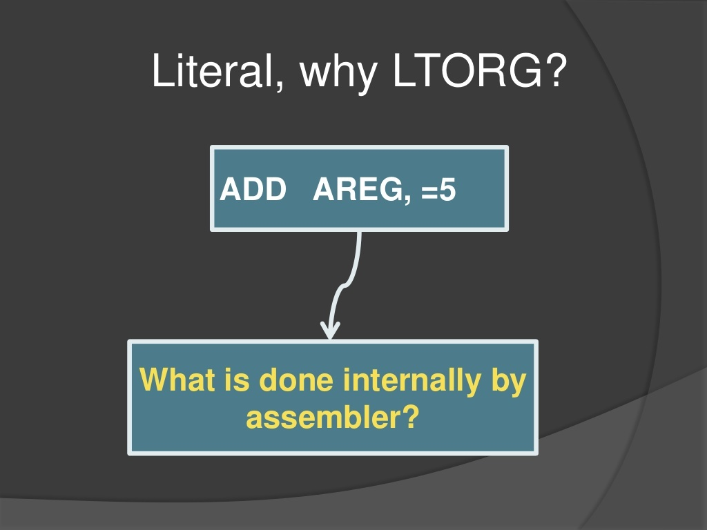

Slide 72
LTORG : (Literal Origin)
Where should the assembler place literals ?
It should be placed such that the control never reaches it during the execution of a program.
By default, the assembler places the literals after the END statement.
LTROG statement permits a programmer to specify where literals should be placed.

Slide 73
LTORG :- This directive is used to assign memory locations to immediate value in between program.
Use the LTORG instruction so that the assembler can collect and assemble literals into a literal pool.
A literal pool contains the literals you specify in a source module either after the preceding LTORG instruction, or after the beginning of the source module.
The creation of a literal pool gives the following advantages:
Automatic organization of the literal data into sections that are correctly aligned and arranged so that minimal space is wasted in the literal pool.
Assembling of duplicate data into the same area.
Because all literals are cross-referenced, you can find the literal constant in the pool into which it has been assembled.

Slide 74
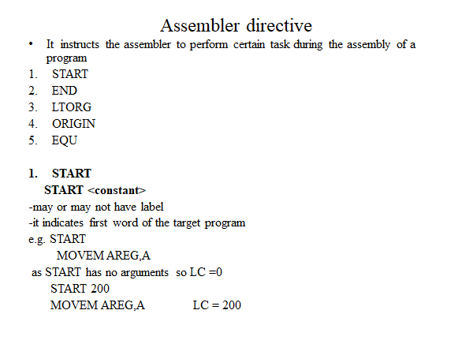

Slide 75
START 200
MOVER AREG,A 🡪 200
MOVEM BREG,=‘2’ 🡪 201
ADD AREG,=‘2’ 🡪 202
START
MOVER AREG,A 🡪 0
MOVEM BREG,=‘2’ 🡪 1
ADD AREG,=‘2’ 🡪 2
START 500
MOVER AREG,A 🡪
MOVEM BREG,=‘2’ 🡪
ADD AREG,=‘2’ 🡪

Slide 76
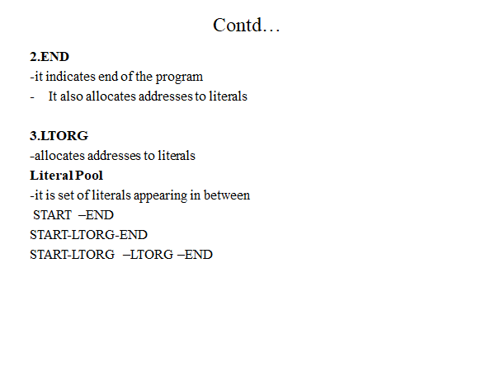

Slide 77


Slide 78


Slide 79
START 200
MOVER AREG,A 🡪 200
MOVEM BREG,=‘2’ 🡪 201
ADD AREG,=‘2’ 🡪 202
ORIGIN LOOP1
MOVER CREG, D
LOOP1 has address 500
START 200
MOVER AREG,A 🡪 200
MOVEM BREG,=‘2’ 🡪 201
ADD AREG,=‘2’ 🡪 202
ORIGIN LOOP1+10
MOVER CREG, D
START 200
MOVER AREG,A 🡪 200
MOVEM BREG,=‘2’ 🡪 201
ADD AREG,=‘2’ 🡪 202
ORIGIN 700
MOVER CREG, D

Slide 80


Slide 81
LITTAB
Literal no. | Literal | Address
1 | =‘2’ | 204
2 | =‘3’ | 205
3 | =‘4’ | 209
4 | =‘2’ | 210
MOVER AREG,A 🡪 200
MOVEM BREG,=‘2’ 🡪 201
ADD AREG,=‘2’ 🡪 202
SUB BREG,=‘3’ 🡪 203
LTORG 🡪 204 ( for = ‘2’ )
🡪 205 ( for = ‘3’ )
MOVER AREG,=‘4 ’ 🡪 206
ADD BREG,=‘2’ 🡪 207
A DC 5 🡪 208
END 🡪 209 ( for =‘4 ‘ )
🡪 210 ( for =‘2’ )
POOLTAB[1]=1
POOLTAB[2]=3

Slide 82


Slide 83


Slide 84


Slide 85


Slide 86


Slide 87

Features of Assembler

Slide 88
OPTAB
Instruction (Mnemonic/ Declaration/ Assembler Directive) | Statement Class | Machine Code
STOP | IS | 00
ADD | IS | 01
SUB | IS | 02
MULT | IS | 03
MOVER | IS | 04
MOVEM | IS | 05
COMP | IS | 06
BC | IS | 07
DIV | IS | 08
READ | IS | 09
PRINT | IS | 10
DC | DL | 01
DS | DL | 02
START | AD | 01
END | AD | 02
ORIGIN | AD | 03
EQU | AD | 04
LTORG | AD | 05
Register Table
Reg name | M/c Code
AREG | 1
BREG | 2
CREG | 3
DREG | 4
Condition Code for BC Instr
Condition | M/c Code
LT | 1
LE | 2
EQ | 3
GT | 4
GE | 5
ANY(NE) | 6

Slide 89
Stmt No | Example ALP
1 | START 200
2 | MOVER AREG, =‘5’
3 | MOVEM AREG, A
4 | LOOP MOVER AREG, A
5 | MOVER CREG, B
6 | ADD CREG, =‘1’
7 | BC ANY, NEXT
8 | LTORG
9 | NEXT SUB AREG, =‘1’
10 | BC LT, BACK
11 | LAST STOP
12 | ORIGIN LOOP+2
13 | MULT CREG, B
14 | ORIGIN LAST+1
15 | A DS 1
16 | BACK EQU LOOP
17 | B DC 1
18 | END

Slide 90
Stmt No | ALP | Intermediate Code
1 | START 200 |  | AD,01 |  | C,200
2 | MOVER AREG, =‘5’ | 200 | IS,04 | 1 | L,1
3 | MOVEM AREG, A | 201 | IS,05 | 1 | S,1
4 | LOOP MOVER AREG, A | 202 | IS,04 | 1 | S,1
5 | MOVER CREG, B | 203 | IS,04 | 3 | S,3
6 | ADD CREG, =‘1’ | 204 | IS,01 | 3 | L,2
7 | BC ANY, NEXT | 205 | IS,07 | 6 | S,4
8 | LTORG | 206 | AD,05 | - | 005
 |  | 207 | AD,05 | - | 001
9 | NEXT SUB AREG, =‘1’ | 208 | IS,02 | 1 | L,3
10 | BC LT, BACK | 209 | IS,07 | 1 | S,5
11 | LAST STOP | 210 | IS,00 | - | -
12 | ORIGIN LOOP+2 |  | AD,03 | - | (S,2)+2
13 | MULT CREG, B | 204 | IS,03 | 3 | S,3
14 | ORIGIN LAST+1 |  | AD,03 | - | (S,6)+1
15 | A DS 1 | 211 | DL,02 | - | C,1
16 | BACK EQU LOOP |  | AD,04 | - | S,2
17 | B DC 1 | 212 | DL,01 |  | C,1
18 | END | 213 | AD,02 | - | 001

Slide 91
Stmt No | ALP | Intermediate Code |  |  |  | Machine Code
1 | START 200 |  | AD,01 |  | C,200
2 | MOVER AREG, =‘5’ | 200 | IS,04 | 1 | L,1 | 200 | 04 | 1 | 206
3 | MOVEM AREG, A | 201 | IS,05 | 1 | S,1 | 201 | 05 | 1 | 211
4 | LOOP MOVER AREG, A | 202 | IS,04 | 1 | S,1 | 202 | 04 | 1 | 211
5 | MOVER CREG, B | 203 | IS,04 | 3 | S,3 | 203 | 05 | 03 | 212
6 | ADD CREG, =‘1’ | 204 | IS,01 | 3 | L,2 | 204 | 01 | 03 | 207
7 | BC ANY, NEXT | 205 | IS,07 | 6 | S,4 | 205 | 07 | 6 | 208
8 | LTORG | 206 | AD,05 | - | 005 | 206 | 00 | 0 | 005
 |  | 207 | AD,05 | - | 001 | 207 | 00 | 0 | 001
9 | NEXT SUB AREG, =‘1’ | 208 | IS,02 | 1 | L,3 | 208 | 02 | 1 | 213
10 | BC LT, BACK | 209 | IS,07 | 1 | S,5 | 209 | 07 | 1 | 202
11 | LAST STOP | 210 | IS,00 | - | - | 210 | 00 | 0 | 000
12 | ORIGIN LOOP+2 |  | AD,03 | - | (S,2)+2
13 | MULT CREG, B | 204 | IS,03 | 3 | S,3 | 204 | 03 | 3 | 212
14 | ORIGIN LAST+1 |  | AD,03 | - | (S,6)+1
15 | A DS 1 | 211 | DL,02 | - | C,1 | 211
16 | BACK EQU LOOP |  | AD,04 | - | S,2
17 | B DC 1 | 212 | DL,01 |  | C,1 | 212
18 | END | 213 | AD,02 | - | 001 | 213 | 00 | 0 | 001

Slide 92
Data Structures Generated after Pass I
SYMTAB
Sym_id | Sym_name | Sym_addr | length
1 | A | 211 | 1
2 | LOOP | 202 | 1
3 | B | 212 | 1
4 | NEXT | 208 | 1
5 | BACK | 202 | 1
6 | LAST | 210 | 1
LITTAB
Lit_no | Literal | addr
1 | =‘5’ | 206
2 | =‘1’ | 207
3 | =‘1’ | 213
POOLTTAB
POOLTAB[1]=1
POOLTAB[2]=3

Slide 93
ALP with Data structures Generated
 | SYMBOL TABLE
Sym_id | Sym_name | Sym_addr | length
1 | A | 211 | 2
2 | LOOP | 202 | 1
3 | B | 213 | 1
4 | NEXT1 | 207 | 1
5 | NEXT2 | 202 | 1
START 200
MOVER AREG,=‘5’ | 200
MOVEM AREG,A | 201
LOOP MOVER AREG,A | 202
MOVER CREG, B | 203
ADD CREG,=‘1’ | 204
LTORG | 205 206
NEXT1 SUB AREG,=‘1’ | 207
ORIGIN LOOP+8
MUL CREG,B | 210
A DS 2 | 211
B DC 3 | 213
NEXT2 EQU LOOP
END | 214
LITERAL TABLE
Lit_no | Literal | addr
LP1 1 | 5 | 205
2 | 1 | 206
LP 2 3 | 1 | 214
POOL TABLE
POOLTAB[1] = 1
POOLTAB[2] = 3

Slide 94
Algorithm for Pass 1 of 2 pass Assembler
Step 1: loc_cntr : = 0; pooltab_ptr := 1; POOLTAB[1] :=1;
Littab_ptr :=1; symtab_ptr:=1;
Step 2: While next stmt is not an END stmt
(a) If label is present then ...................
(b) If an LTORG stmt then .................
(c ) If START or ORIGIN stmt then .............
(d) If an EQU stmt then ……………….
(e) If a declaration stmt then ………………
(f) If an imperative stmt then ……………….
Step 3: Processing of END stmt
(a) Perform step 2(b)
(b) Generate Intermediate code.
(C) Goto Pass 2 .

Slide 95
Label Processing
(a) If label is present then
this_label = symbol in label field
Enter(this_label, loc_cntr) in SYMTAB
◄

Slide 96
Literal Processing
(b) If an LTORG stmt then
i. Process literals LITTAB[POOLTAB[pooltab_ptr]]……
LITTAB[POOLTAB[pooltab_ptr+1]]-1]
to allocate memory and put the address field.
Update loc_cntr.
ii. Pooltab_ptr:=pooltab_ptr+1;
iii. POOLTAB[pooltab_ptr] := littab_ptr;
◄

Slide 97
START ORIGIN and EQU Processing
(c ) If START or ORIGIN stmt then
loc_cntr := value in operand field
(d) If an EQU stmt then
this_addr=value of <address spec>
update the SYMTAB entry
◄

Slide 98
Declaration(DS/DC) Statement Processing
(e) If a declaration stmt then
code = code of declaration stmt,
size = size req by DC/DS
update the SYMTAB entry
loc_cntr = loc_cntr + size
generate Intermediate code
◄

Slide 99
Imperative Statement Processing
(f) If an imperative stmt then
code = m/c code from MOT,
loc_cntr = loc_cntr + length of instr
If operand is literal then
this_lit = literal in operand field
LITTAB[littab_ptr] = this_lit
littab_ptr = littab_ptr + 1
else this_entry = SYMTAB entry no of operand
symtab_ptr = symtab_ptr + 1
◄

Slide 100
Pass-1:
Define symbols and literals and remember them in symbol table and literal table respectively.
Keep track of location counter
Process pseudo-operations
Pass-2:
Generate object code by converting symbolic op-code into respective numeric op-code
Generate data for literals and look for values of symbols

Slide 101


Slide 102
There are two variant of Intermediate code
Variant-1
We may have IS, AD , DL in our program so we have to write ( class, its number )
2) Operand registers are written with single digit.
3) The second operand which is a memory operand, is represented by a pair of the form ( operand class, code ) Where operand class is one of C, S and L standing for constant, symbol and literal respectively.
4) The first operands may be register value for instruction. If the instruction is BC then first operand is having value 1 to 6 .
Variant-02
1) Variant 2 will be same for AD and DL. Only for IS the first operand is written as it is. For second operand only for literal they follow VARIANT format, rest all is written as it is from input.

Slide 103


Slide 104


Slide 105


Slide 106


Slide 107
Algorithm for Pass 2 of 2 pass Assembler
Machine_code_buffer :area for constructing code for one statement
Code_area: area for assembling the target program ,
code_area_address :contains address of code_area
code_area_addr=addr of code_area,
pooltab_ptr=1,
loc_cntr=0

Slide 108
Algorithm for Pass 2 of 2 pass Assembler (contd…)
2. While next stmt is not an END stmt
clear machine_code_buffer
If an LTORG stmt
(i) Process literals in
LITTAB[POOLTAB[pooltab_ptr]]……..LITTAB[POOLTAB[pooltab_ptr+1]-1]
assemble literals in machine_code_buffer.
(ii) size=size of memory req for literals (iii)pooltab_ptr=pooltab_ptr+1
If a START or ORIGIN stmt then
(i) loc_cntr=value specified in operand field (ii) size=0
If a declaration stmt
(i) If a DC stmt then
Assemble the const in machine_code_buffer.
(ii) size=size of memory required by DC/DS stmt
If an imperative stmt
(i) Get operand address from SYMTAB or LITTAB
(ii) Assemble instr in machine_code_buffer. (iii) size=size of instr
If size <> 0 then
(i) Move contents of machine_code_buffer to the address code_area_addr+loc_cntr
(ii) loc_cntr=loc_cntr+size
3.Processing of END stmt
Perform step 2(b) and 2(f)
Write code_area into output file.

Slide 109
Listing and error reporting in Pass-1
Syntax errors(missing commas or parenthesis)
Semantic errors (duplicate definitions of symbols)
References to undefined variables
Sr. No Stmt address
001 START 200
002 MOVER AREG,A 200
003 ….
009 MVER BREG,A 207
**ERROR ** INVALID OPCODE
010 ADD BREG,B 208
014 A DS 1 209
015 …….
021 A DC ‘5’ 227
** ERROR ** DUPLICATE DEFINITION OF SYM A
022 ………
035 END

Slide 110
ERRORS IN PASS 2
Sr. No Stmt address
001 START 200
002 MOVER AREG,A 200
003 ….
009 MVER BREG,A 207
**ERROR ** INVALID OPCODE
ADD BREG,B 208
** ERROR ** UNDEFINED SYM B IN OPERAND FIELD
014 A DS 1 209
015 …….
021 A DC ‘5’ 227
** ERROR ** DUPLICATE DEFINITION OF SYM A
022 ………
035 END

Slide 111


Slide 112


Slide 113


Slide 114


